Slide 1
Solve Problems about Liquid Volume & Mass
MAFS.3.MD.1.2

Slide 2
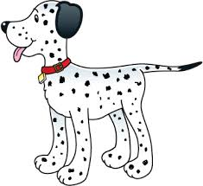
Lesson Opening
Andrea’s puppy, Goober, weighed 6 kilograms when she got him. Three years later Goober weighed 34 kilograms. How many pounds did Goober gain in three years?
?
+4
+20
+4
6
10
30
34
20 + 4 + 4 = 28
Goober gained 28 pounds.

Slide 3
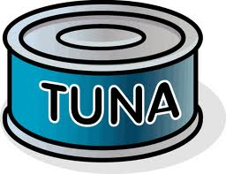
Not all problems will involve addition and subtraction. Try this one.
Lo’s Sandwich Shop bought 45 pounds of tuna to make tuna salad. She sells all 45 pounds of tuna in 9 days. If Lo sells about the same amount of tuna each day, how many pounds does she sell each day?
45 pounds
?
There are 9 boxes to represent 9 days.

Slide 4
Not all problems will involve addition and subtraction. Try this one.
Lo’s Sandwich Shop bought 45 pounds of tuna to make tuna salad. She sells all 45 pounds of tuna in 9 days. If Lo sells about the same amount of tuna each day, how many pounds does she sell each day?
45 pounds
5
?
5
5
5
5
5
5
5
5
There are 9 boxes to represent 9 days.
She sells 5 pounds of tuna each day.

Slide 5
Your Turn.
Work in small groups to solve the problems from the practice pages. What you don’t finish in class will become your homework.

Slide 6
Exit Ticket
Nicole has a bucket filled with 16 liters of water. When she finishes mopping the floor, her bucket has 9 liters of water. How much water did Nicole use to mop the floor?
Soraya is making fruit punch for a really big party. Each package of fruit punch powder takes 3 liters of water. If Soraya makes 7 packages of fruit punch how many liters of water will she need?

