Slide 1
Problems of the Day
Unit 4: Understand Fractions

Slide 2
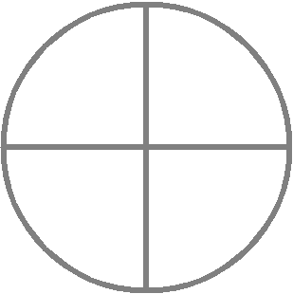
8.1: Equal Parts of a Whole
Which models shows fourths? (Choose all that apply.)
v
MAFS.3.NF.1.1

Slide 3
8.3 Unit Fractions of a Whole
MAFS.3.NF.1.1

Slide 4
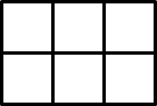
8.4 Fractions of a Whole
MAFS.3.NF.1.1

Slide 5
Supplement: Unit Fractions on a Number Line
0
1
MAFS.3.NF.1.2

Slide 6
8.5 Fractions on a Number Line
Write the fraction that names the point on the number line.
Name the fraction that represents the length on the number line.
0
1
0
1
0
1
0
1
MAFS.3.NF.1.2

Slide 7
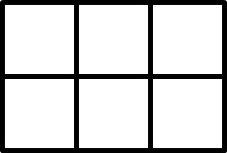
Supplement: Model Fractions Greater than 1
A
B
C
D
0
1
MAFS.3.NF.1.1/2

Slide 8
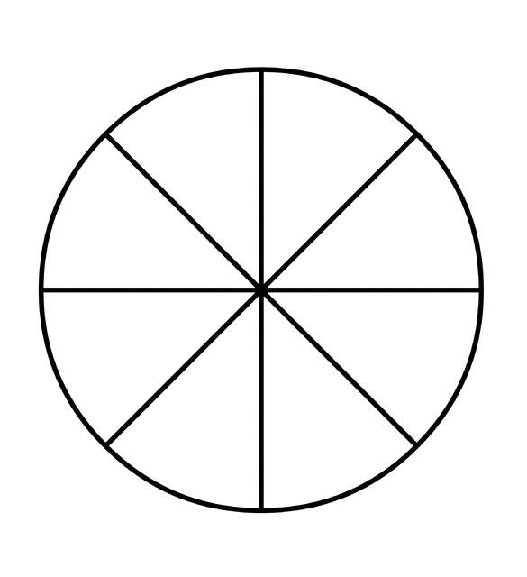
8.6 Relate Fractions and Whole Numbers
0
MAFS.3.NF.1.3c

Slide 9
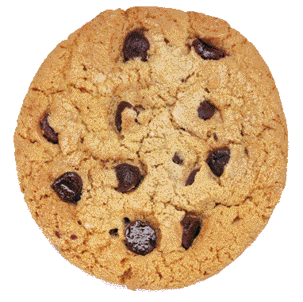
8.2 Equal Shares
If 4 friends share 3 cookies equally, how much will each friend receive?
If 3 friends share 4 cookies equally, how much will each friend receive?
MAFS.3.NF.1.1

