Slide 1
Finding Perimeter using a Grid
How can you find perimeter?

Slide 2
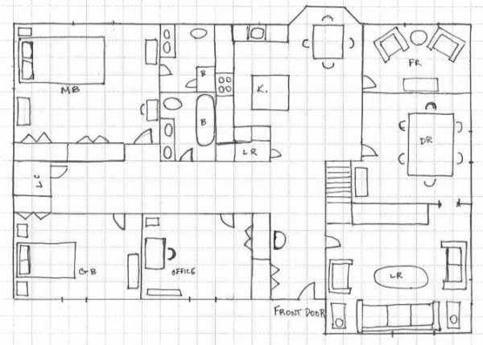

Slide 3
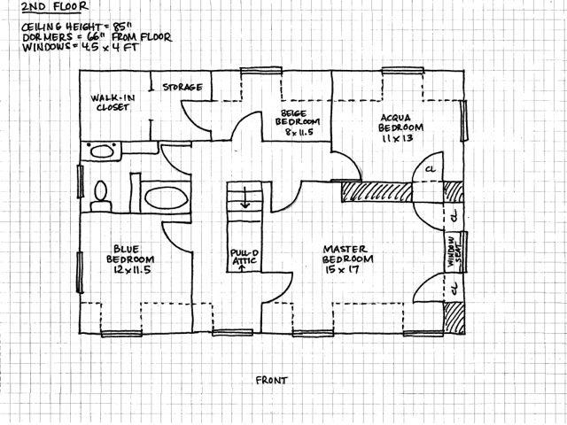

Slide 4
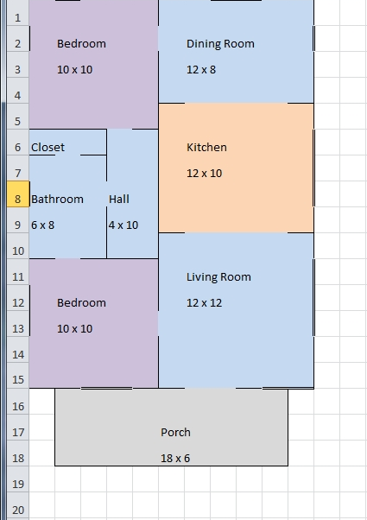

Slide 5
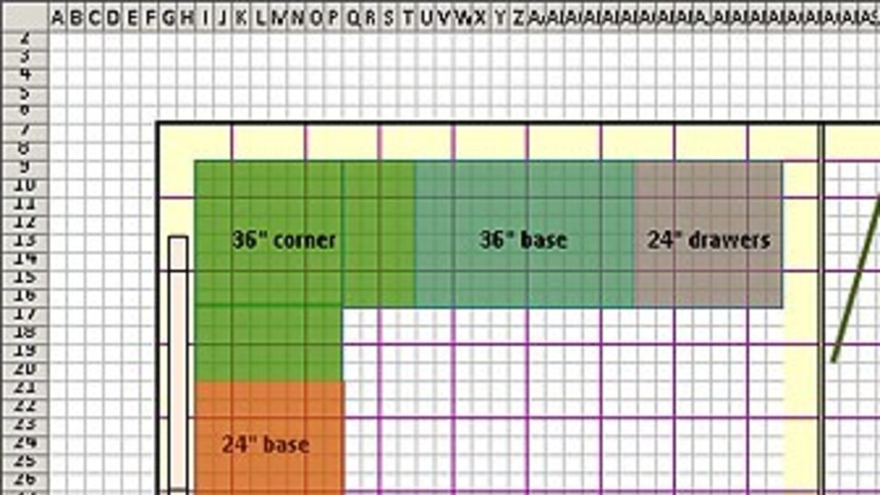

Slide 7
To find the perimeter count
the grid lines on all the sides.

Slide 8
 |  |  |  |  |  | 1 | 2 | 3
To find the perimeter count
the grid lines on all the sides.

Slide 9
 |  |  |  |  |  | 1 | 2 | 3
 |  |  |  |  | 14 |  |  |  | 4
 |  |  |  |  | 13 |  |  |  | 5
 |  |  |  |  | 12 |  |  |  | 6
 |  |  |  |  | 11 |  |  |  | 7
 |  |  |  |  |  | 10 | 9 | 8
To find the perimeter count
the grid lines on all the sides.

Slide 10
 |  |  |  |  |  | 1 | 2 | 3
 |  |  |  |  | 14 |  |  |  | 4
 |  |  |  |  | 13 |  |  |  | 5
 |  |  |  |  | 12 |  |  |  | 6
 |  |  |  |  | 11 |  |  |  | 7
 |  |  |  |  |  | 10 | 9 | 8
This perimeter of this figure
is 14 units.

Slide 12
To find the perimeter count
the grid lines on all the sides.

Slide 13
 |  |  | 1 | 2 | 3 | 4 | 5 | 6 | 7 | 8 | 9
To find the perimeter count
the grid lines on all the sides.

Slide 14
 |  |  | 1 | 2 | 3 | 4 | 5 | 6 | 7 | 8 | 9
9 units
To find the perimeter count
the grid lines on all the sides.

Slide 15
 |  |  | 1 | 2 | 3 | 4 | 5 | 6 | 7 | 8 | 9
9 units
8 units
3 units
3 units
5 units
6 units

Slide 16
 |  |  | 1 | 2 | 3 | 4 | 5 | 6 | 7 | 8 | 9
9 units
8 units
3 units
3 units
5 units
6 units
9 + 3 + 3 + 5 + 6 + 8 = 34 units

Slide 17
