Slide 1
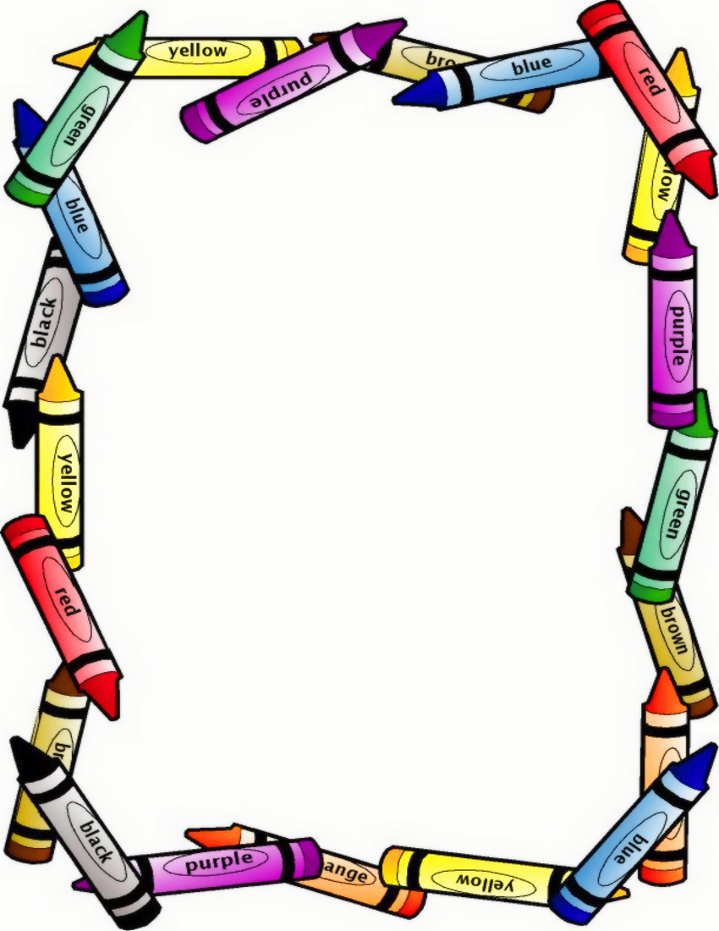
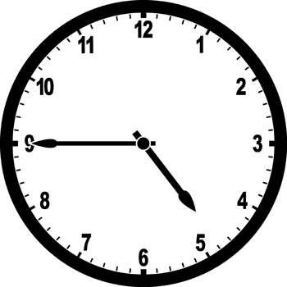
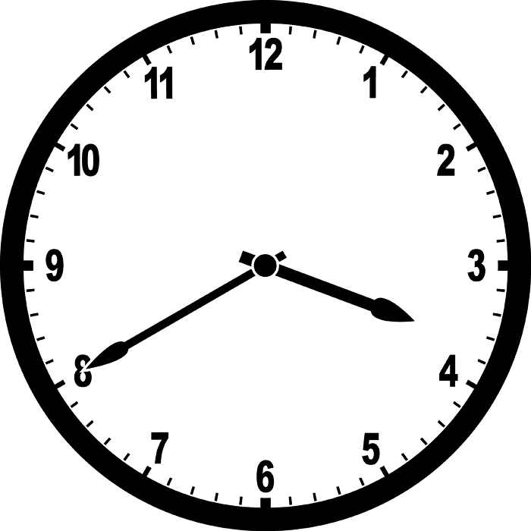
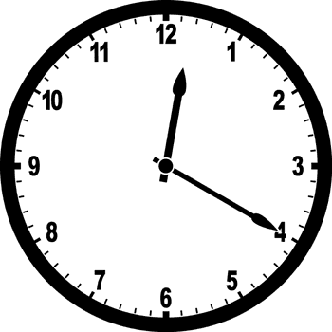
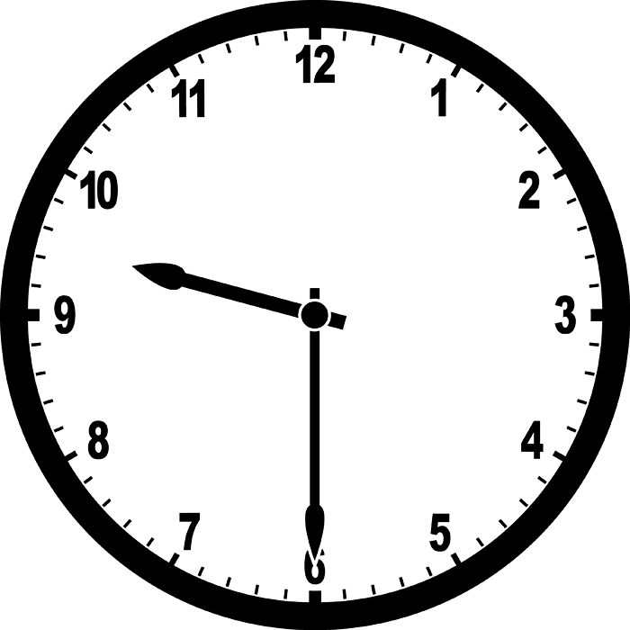
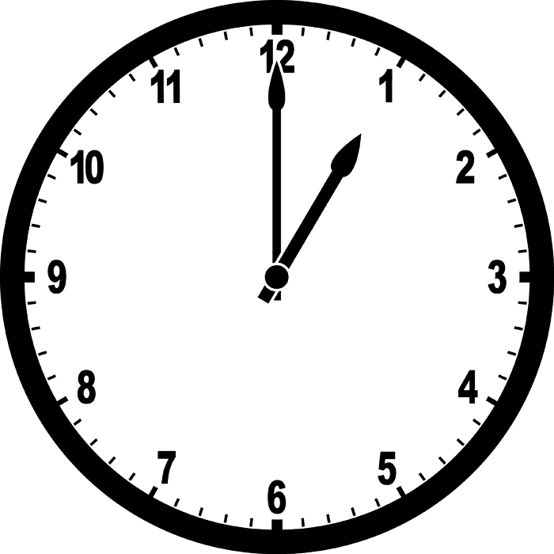
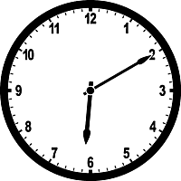
I have…
I have…
Who has 3:40?
Who has 12:20?
I have…
I have…
Who has 9:30?
Who has 1:00?
I have…
I have…
Who has 6:05?
Who has the start?

Slide 2
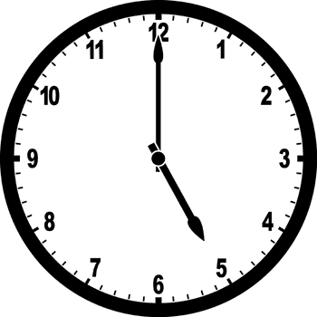
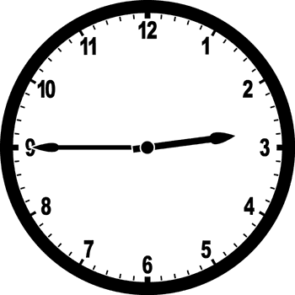
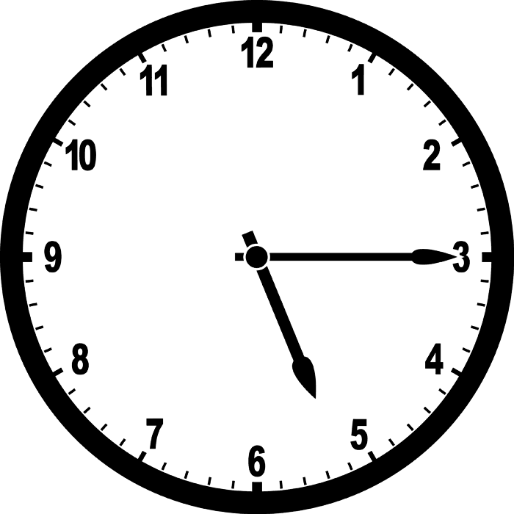
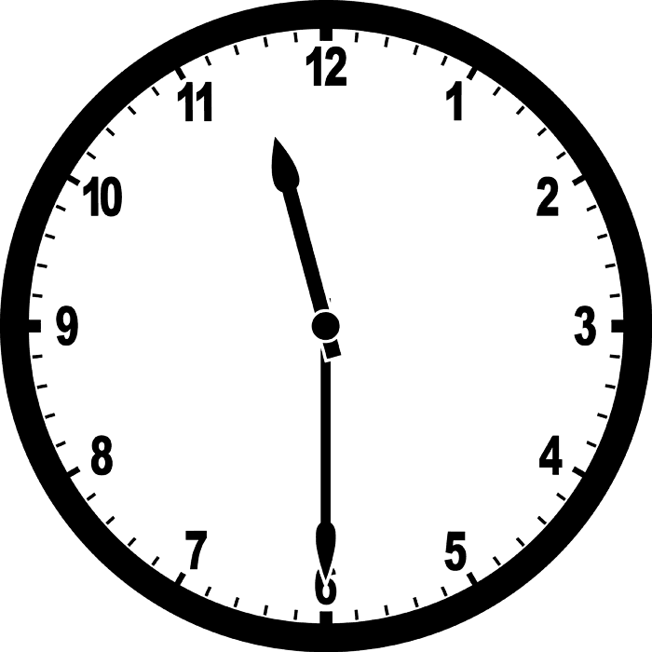
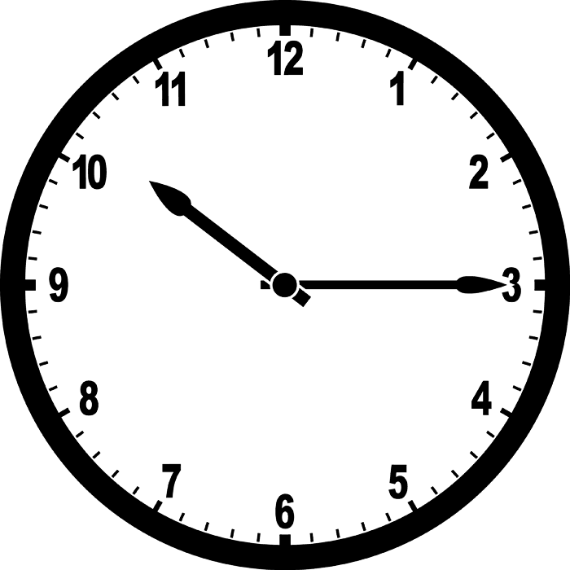
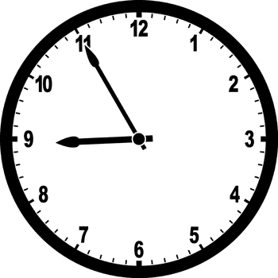
I have…
I have…
Who has 2:45?
Who has 5:15?
I have…
I have…
Who has 10:15?
Who has 11:30?
I have…
I have…
Who has 8:55?
Who has 4:45?

Slide 3
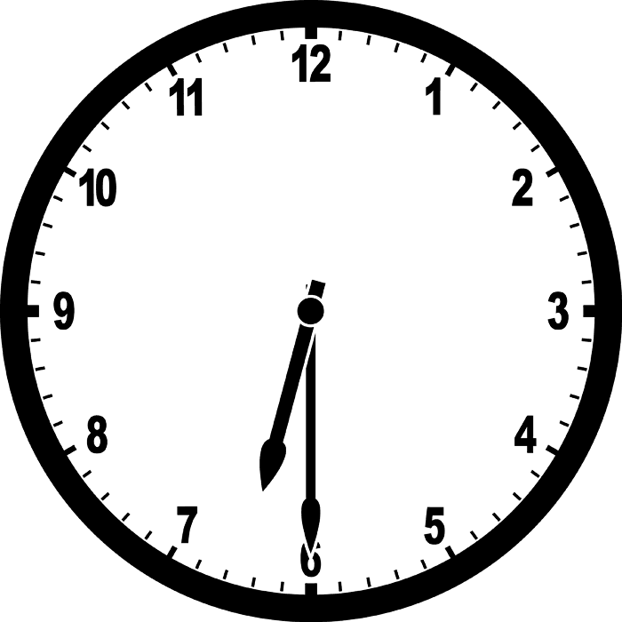
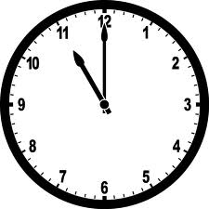
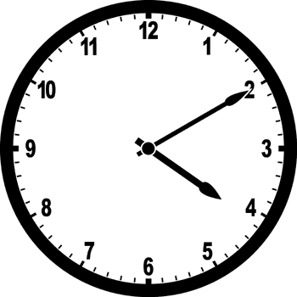
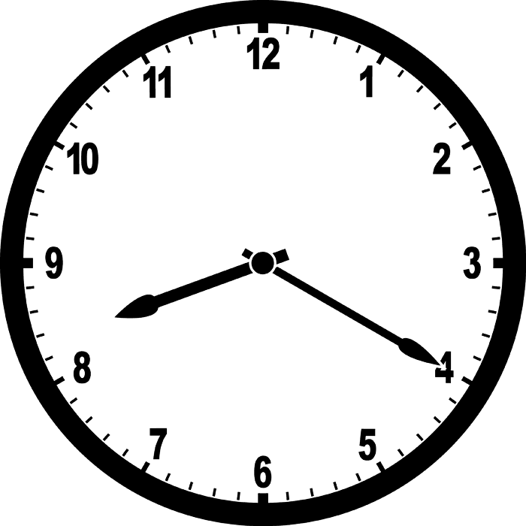
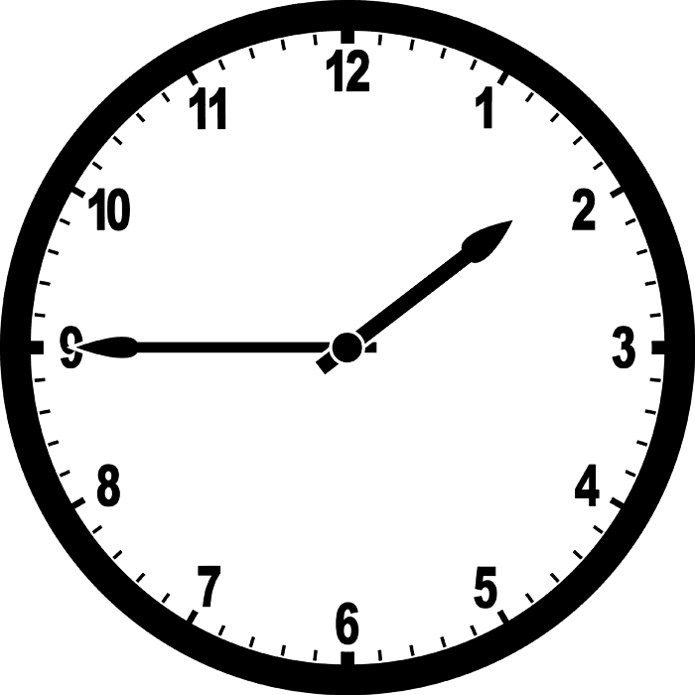
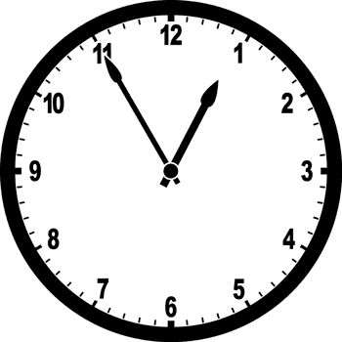
I have…
I have…
Who has 11:00?
Who has 4:10?
I have…
I have…
Who has 1:45?
Who has 8:20?
I have…
I have…
Who has 12:55?
Who has 5:00?

Slide 4
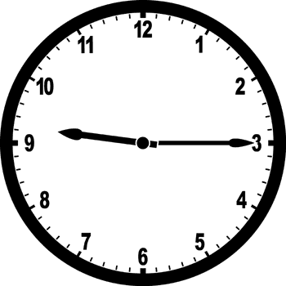
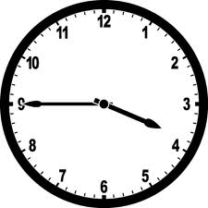
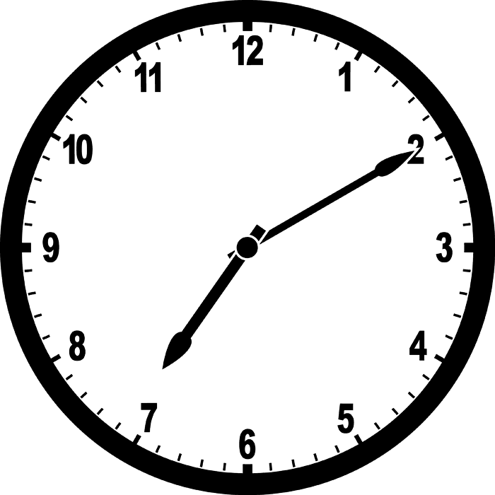
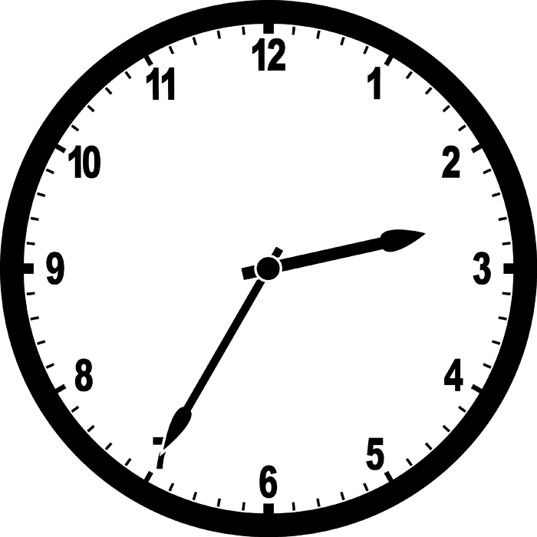
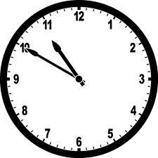
Starting Card
☺
I have…
Who has 9:15?
Who has 3:45?
I have…
I have…
Who has 2:35?
Who has 7:10?
I have…
I have…
Who has 10:50?
Who has 6:30?

Slide 5
I Have, Who has?
Start-9:15
9:15- 3:45
3:45- 7:10
7:10- 2:35
2:35- 10:50
10:50- 6:30
6:30-11:00
11:00-4:10
4:10-8:20
8:20- 1:45
1:45- 12:55
12:55- 5:00
5:00- 2:45
2:45- 5:15
5:15-11:30
11:30- 10:15
10:15- 8:55
8:55- 4:45
4:45- 3:40
3:40- 12:20
12:20- 9:30
9:30- 1:00
1:00- 6:05
6:05- start

