Slide 1
Subtraction Strategies
MAFS.3.NBT.1.2

Slide 2
Lesson Opening
Find the difference.
92 – 48

Slide 3
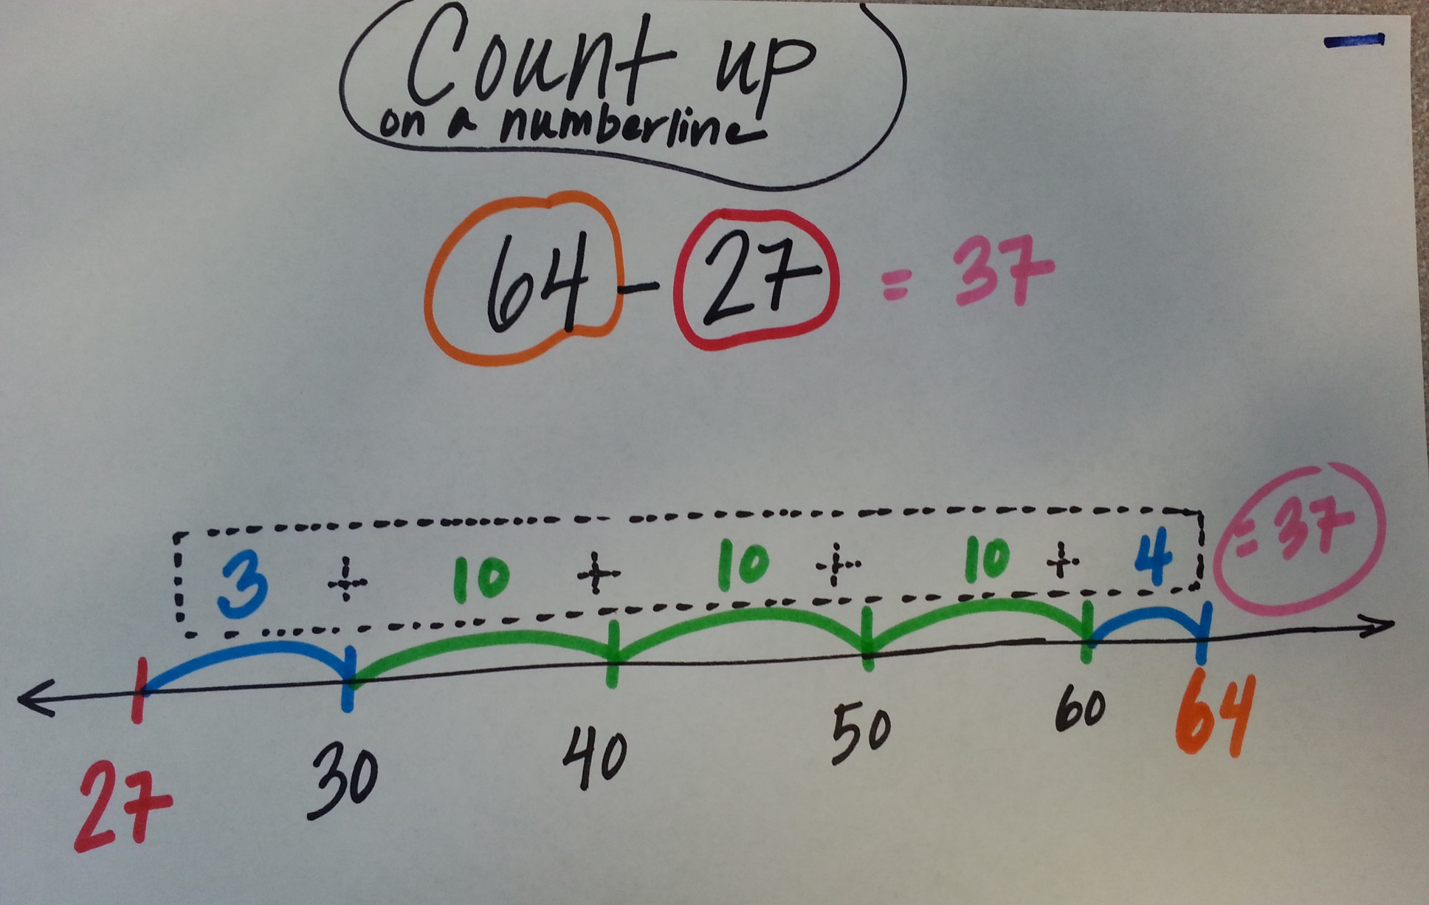
Try this strategy to find the difference.
54
- 38

Slide 4
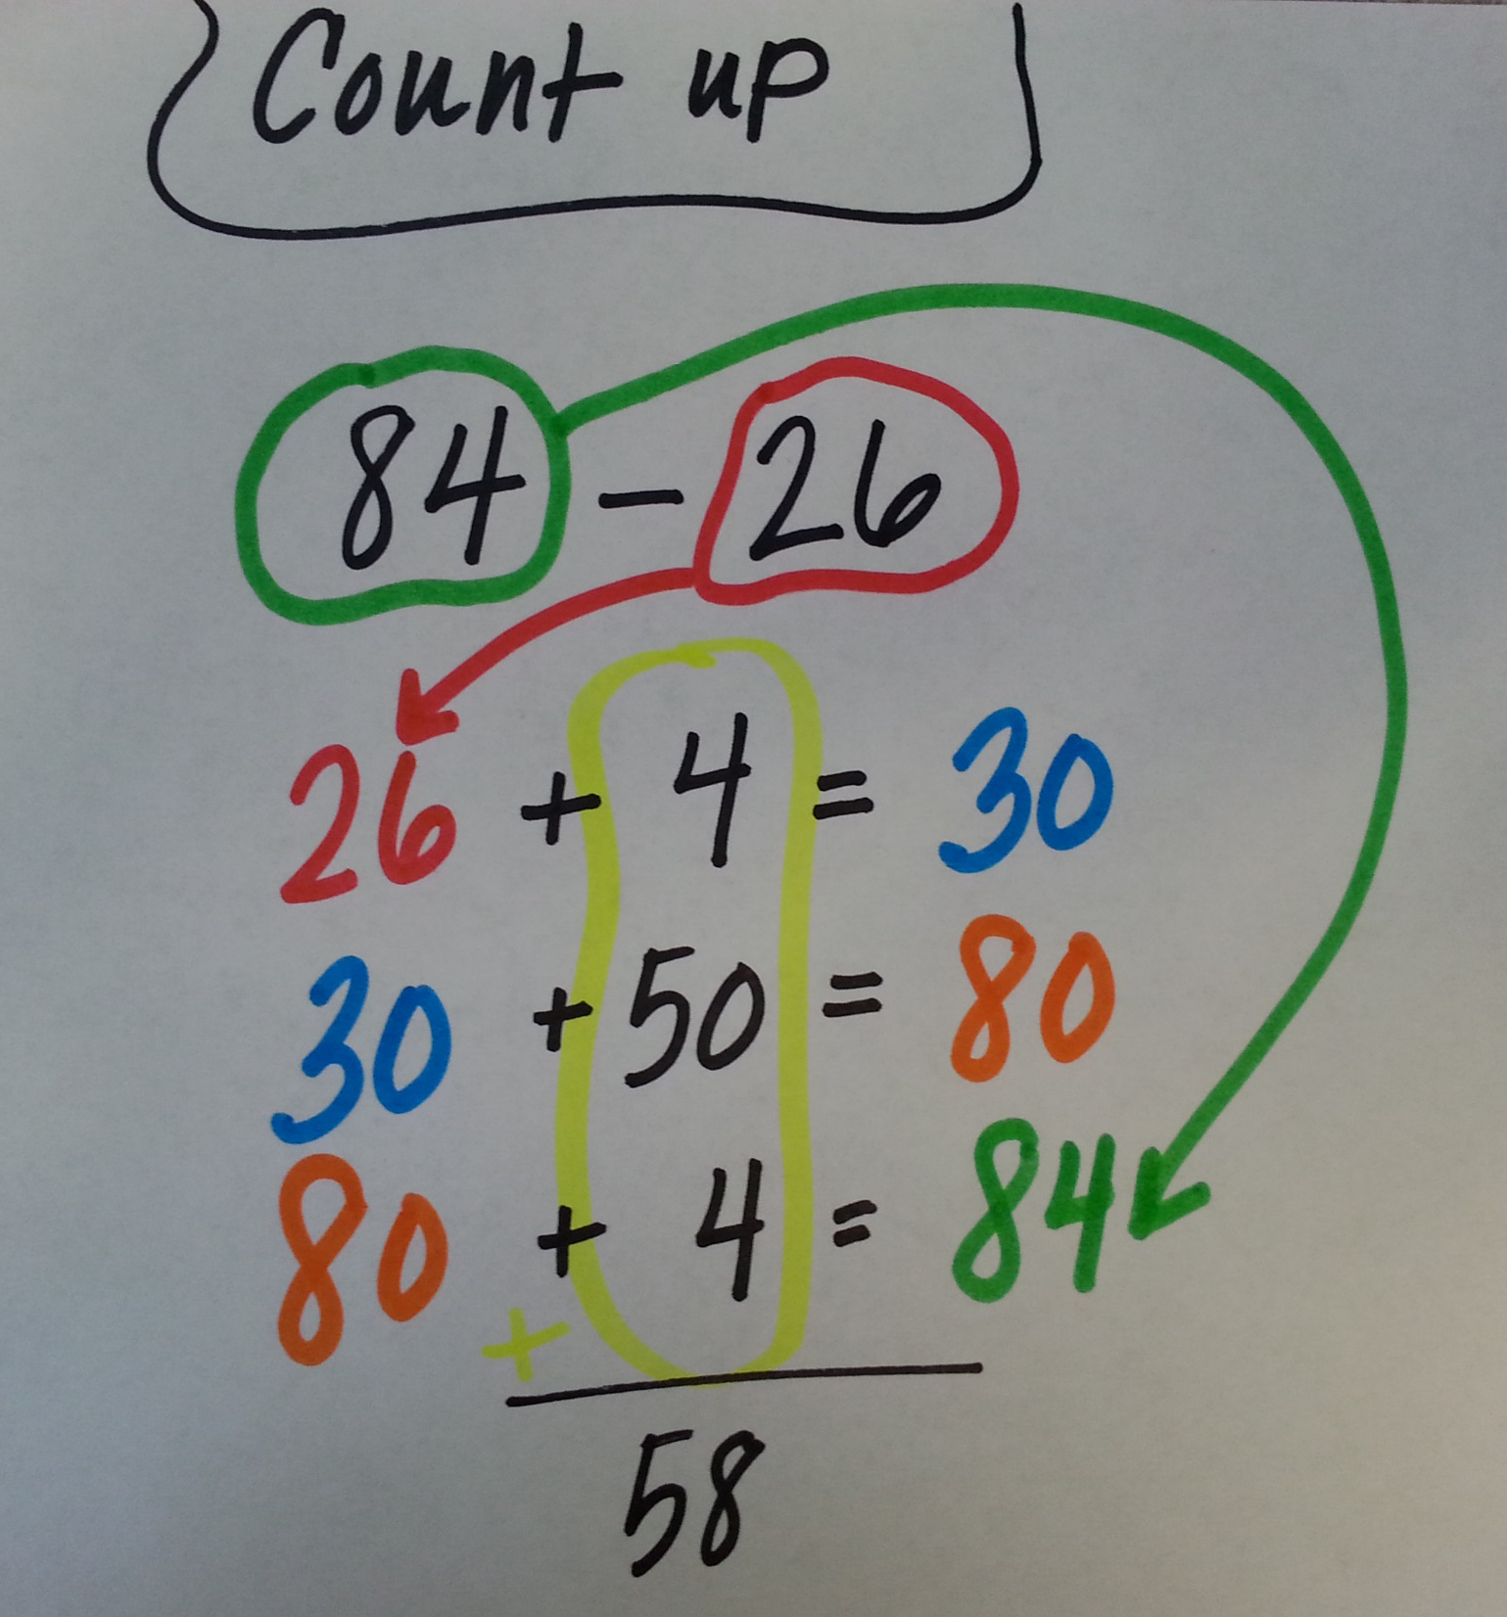
Try this strategy to find the difference.
153
- 138

Slide 5
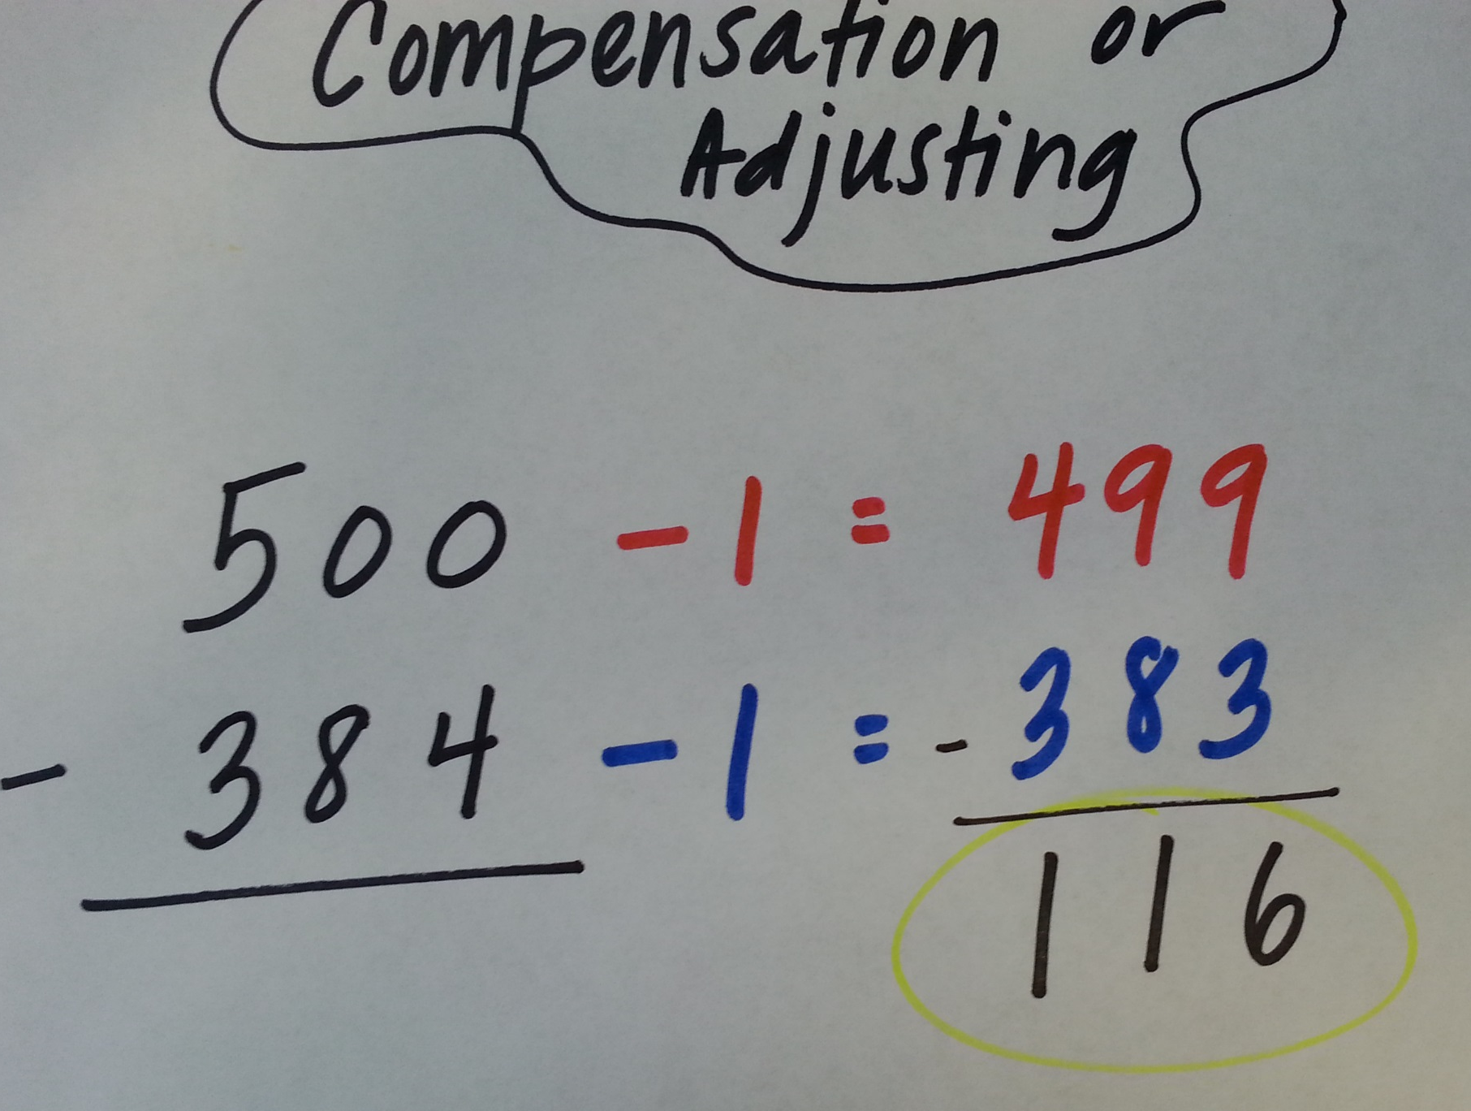
Try one of this strategy to find the difference.
350
- 297

Slide 6
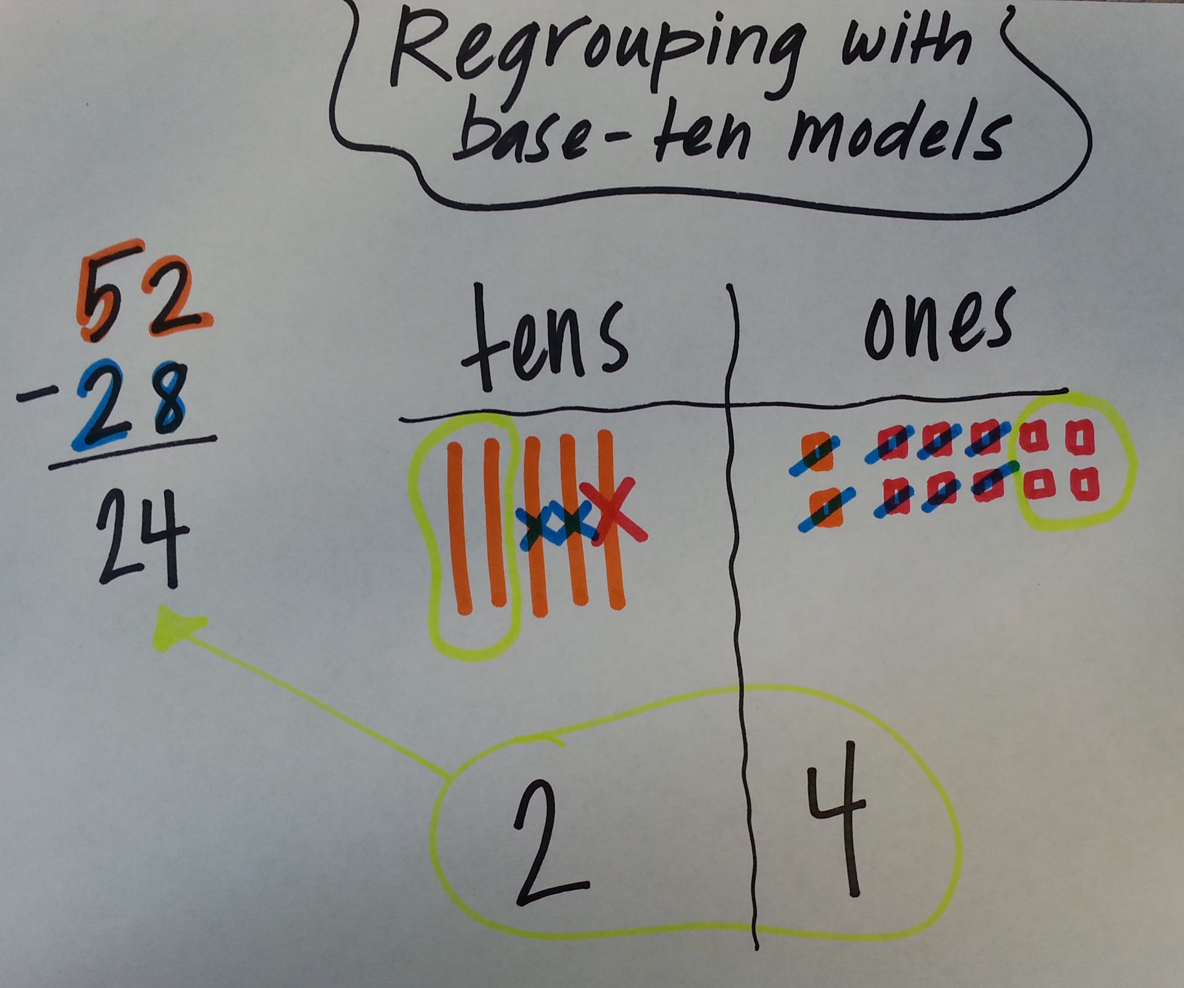
Try this strategy to find the difference.
81
- 68

Slide 7
Choose a strategy to solve.
In groups of 3 or 4, make a poster of four strategies you know how to use to solve this problem. The poster needs to show the four different strategies.
Be ready to share which strategy you think is the most efficient.
343 – 198

Slide 8
Exit Ticket
What is the difference between 459 and 397?
Solve: 81 – 48

