Slide 1
Addition Strategies
MAFS.3.NBT.1.2

Slide 2
Lesson Opening
Find the sum.
56 + 39

Slide 3
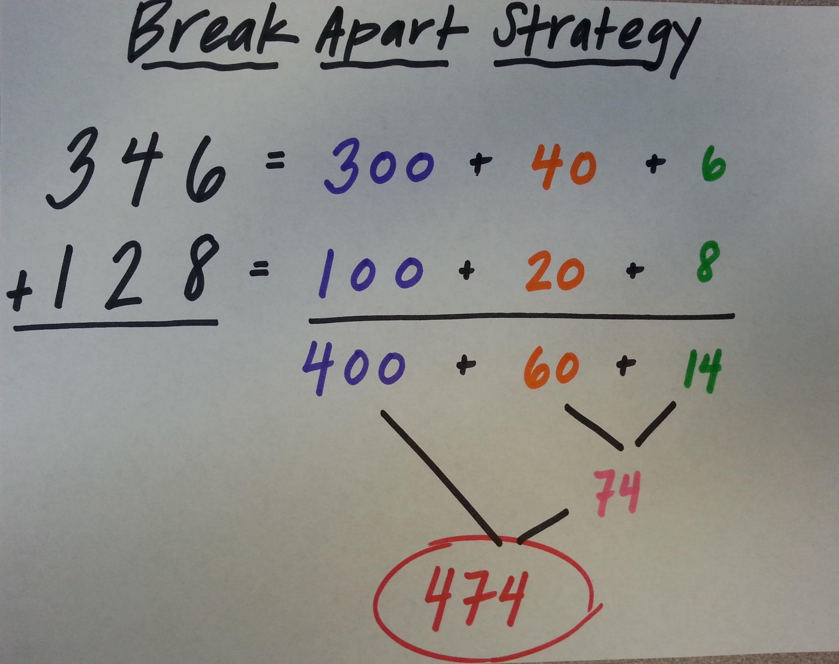
Try this strategy to find the sum.
154
+ 27

Slide 4
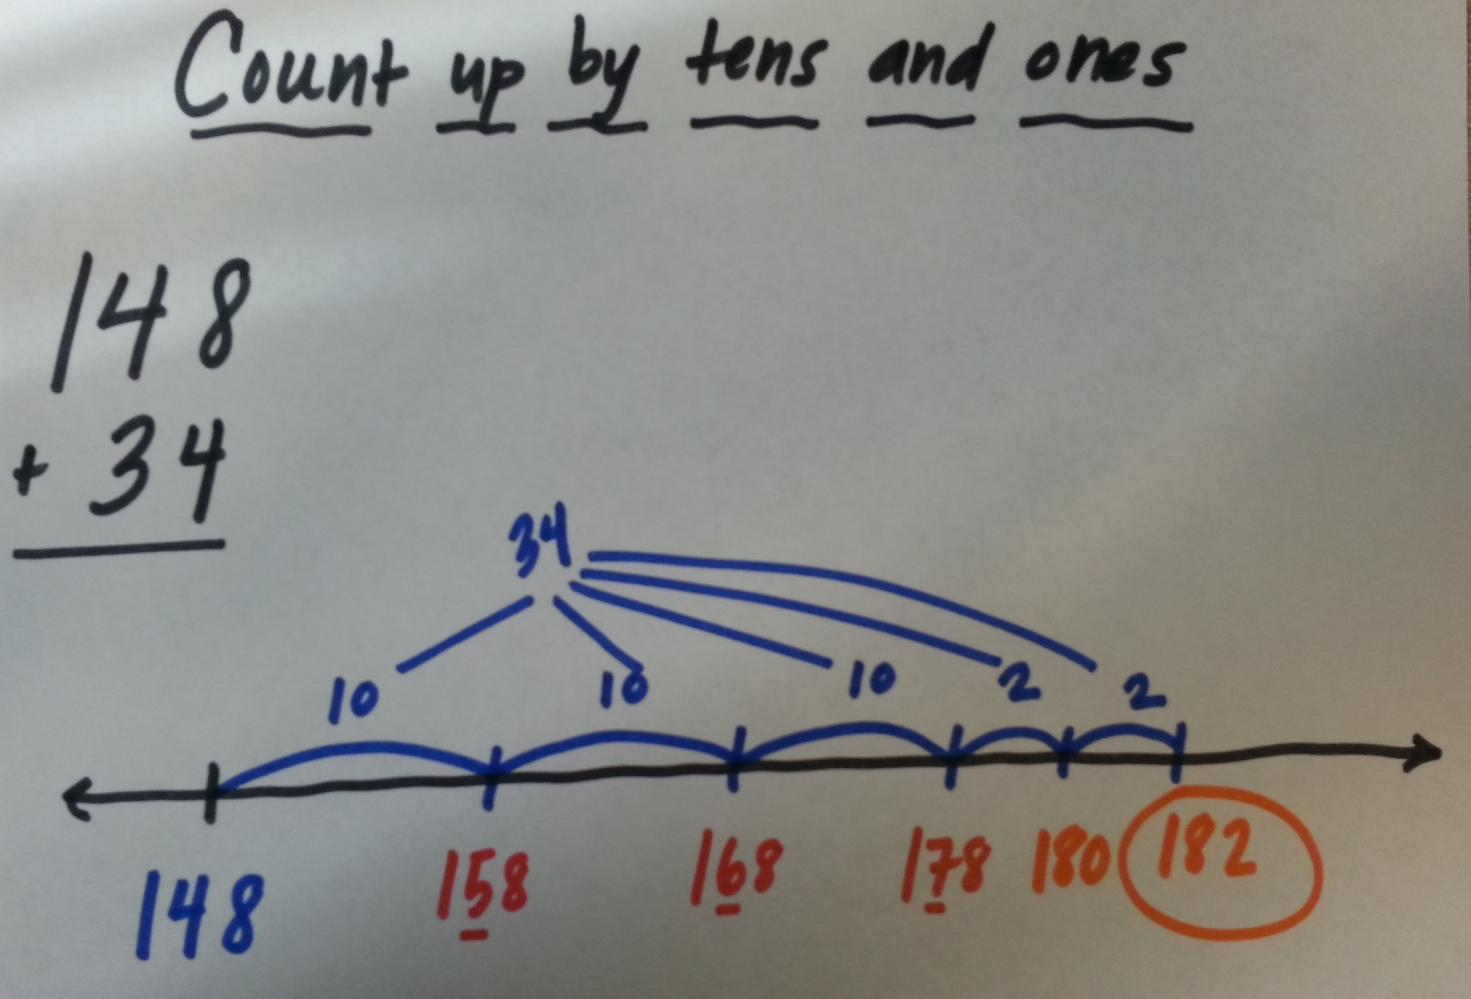
Try this strategy to find the sum.
228
+ 33

Slide 5
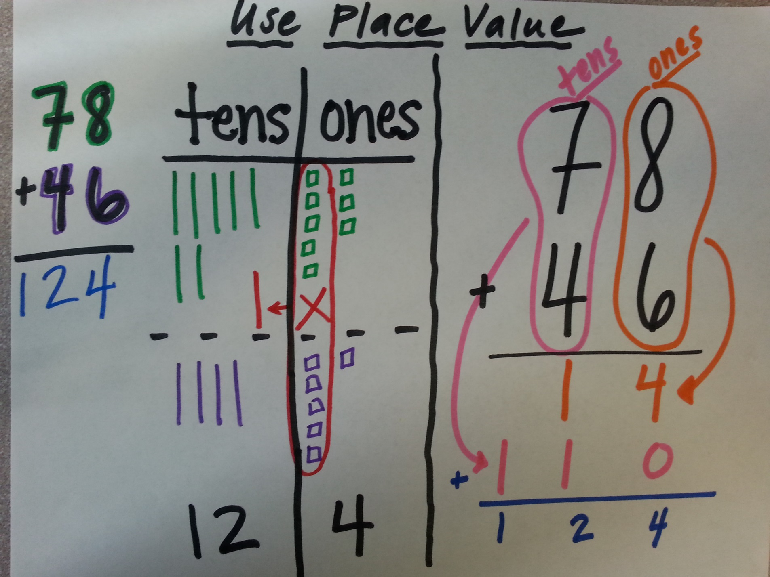
Try one of these strategies to find the sum.
69
+ 47

Slide 6
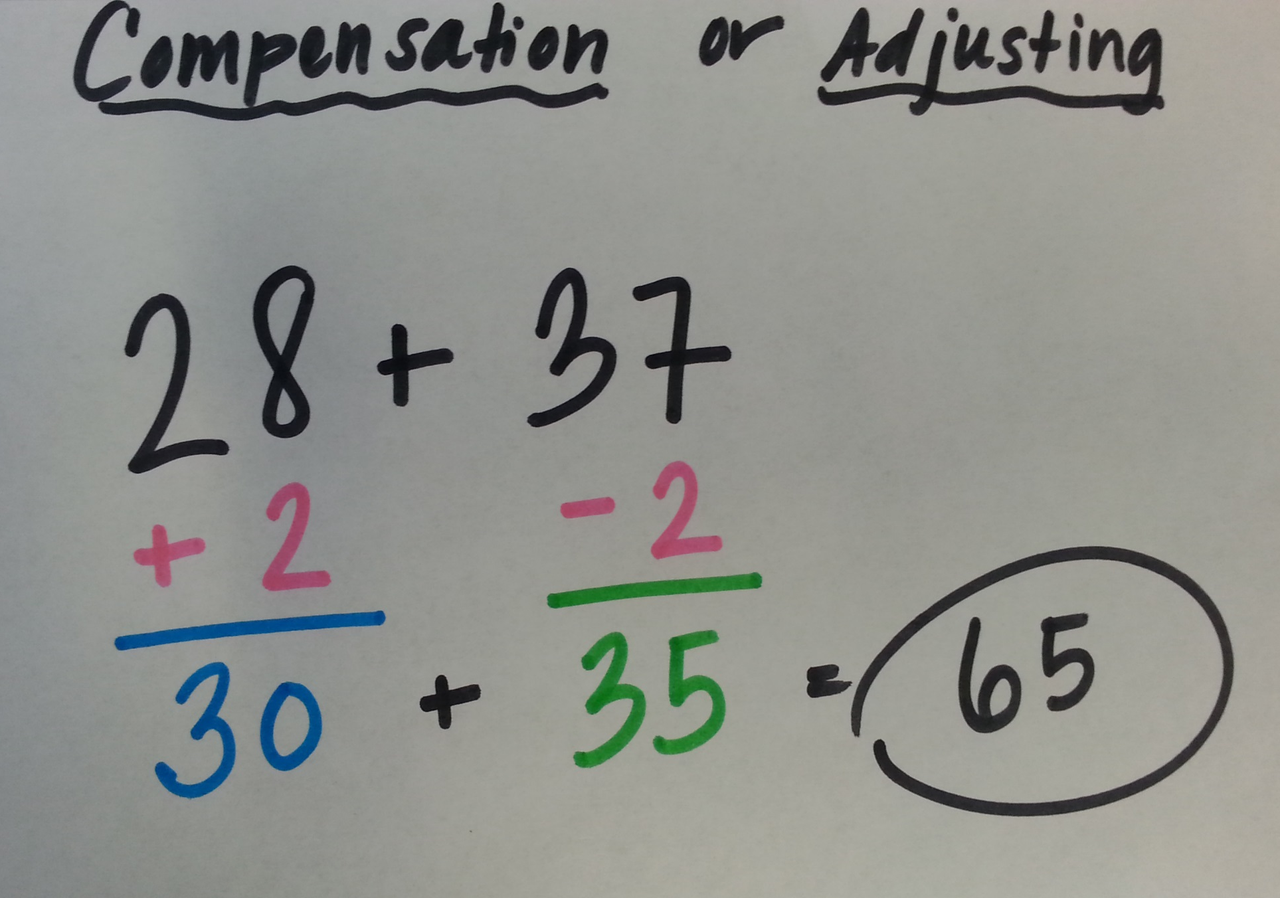
Try this strategy to find the sum.
59
+ 23

Slide 7
Choose a strategy to solve.
In groups of 3 or 4, make a poster of four strategies you know how to use to solve this problem. The poster needs to show the four different strategies.
Be ready to share which strategy you think is the most efficient.
343 + 98

Slide 8
Exit Ticket
What is the sum of 46, 24, and 120?
What is 456 + 390?

