Slide 1
Rounding to the Nearest Ten & Hundred
MAFS.3.NBT.1.1

Slide 2
Lesson Opening
Write the correct number under each tick mark on the number lines below.
83
66

Slide 3
Lesson Opening
Write the correct number under each tick mark on the number lines below.
80
81
82
83
84
85
86
87
88
89
90
60
61
62
63
64
65
66
67
68
69
70

Slide 4
Round to the Nearest Ten
83 is closer to 80 than it is to 90, so 83 rounded to the nearest ten is 80.
The purple numbers are closest to which TEN (multiple of ten)?
66 is closer to 70 than it is to 60, so 66 rounded to the nearest ten is 70.
80
81
82
83
84
85
86
87
88
89
90
60
61
62
63
64
65
66
67
68
69
70

Slide 5
Round to the Nearest Ten
Fill out this number line.
480
481
482
483
484
485
486
487
488
489
490

Slide 6
Round to the Nearest Ten
Which TEN (multiple of ten) is 483 closer to?
483 is closer to 480 than it is to 490, so 483 rounded to the nearest ten is 480.
480
481
482
483
484
485
486
487
488
489
490

Slide 7
What’s the difference in rounding to the nearest ten in the numbers below?
480
481
482
483
484
485
486
487
488
489
490
80
81
82
83
84
85
86
87
88
89
90

Slide 8
Round to the Nearest Ten
Fill out this number line.
760
761
762
763
764
765
766
767
768
769
770

Slide 9
Round to the Nearest Ten
Which TEN (multiple of ten) is 766 closer to?
760
761
762
763
764
765
766
767
768
769
770

Slide 10
What’s the difference in rounding to the nearest ten in the numbers below?
760
761
762
763
764
765
766
767
768
769
770
60
61
62
63
64
65
66
67
68
69
70

Slide 11
Rounding to the nearest HUNDRED
The number 483 is between which two HUNDREDS?
400
483
500
483 is closer to 500 than it is to 400, so 483 rounded to the nearest HUNDRED is 500.

Slide 12
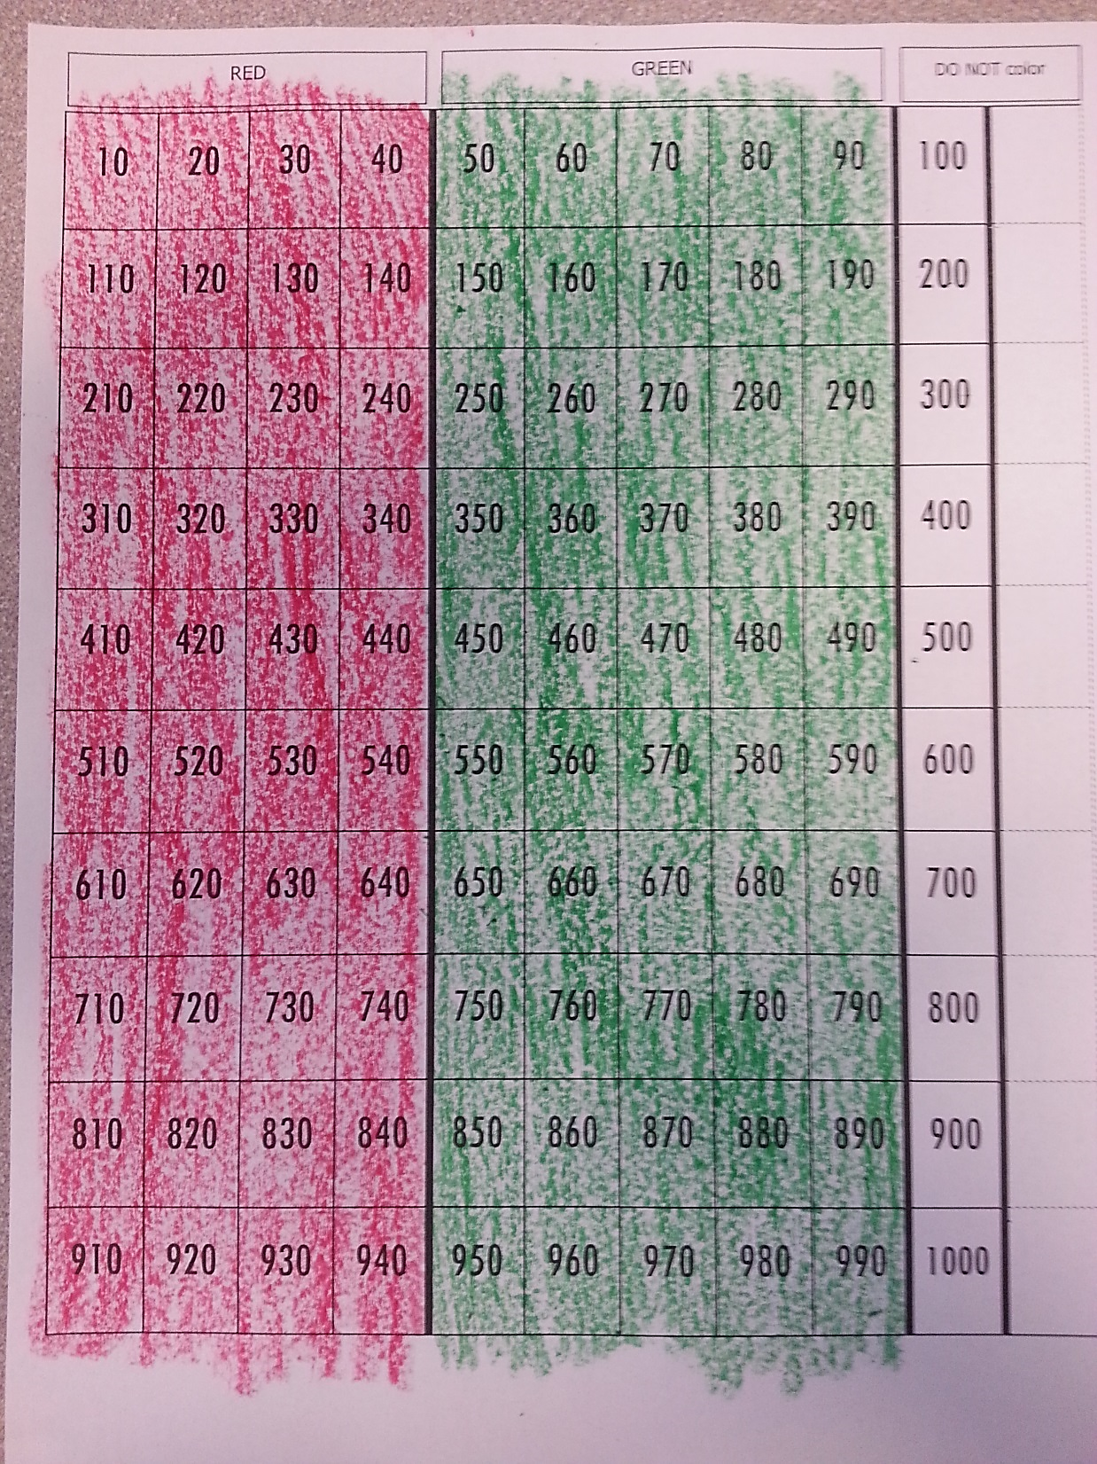
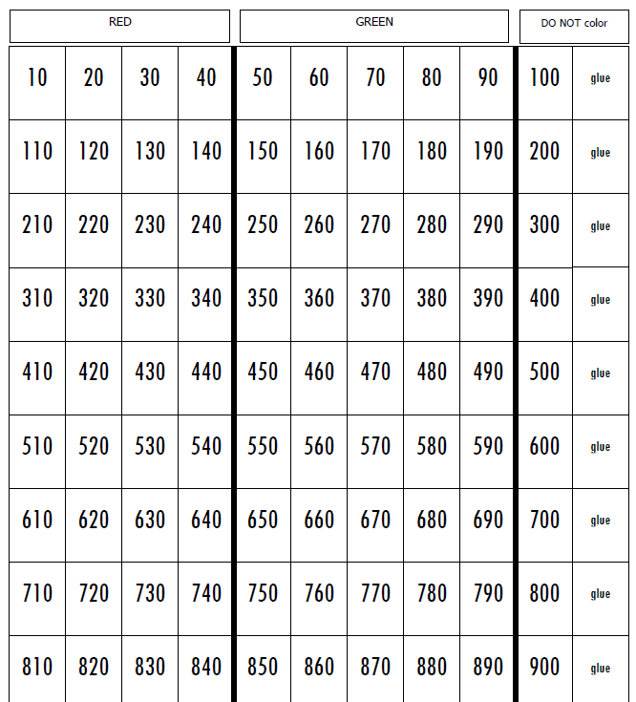
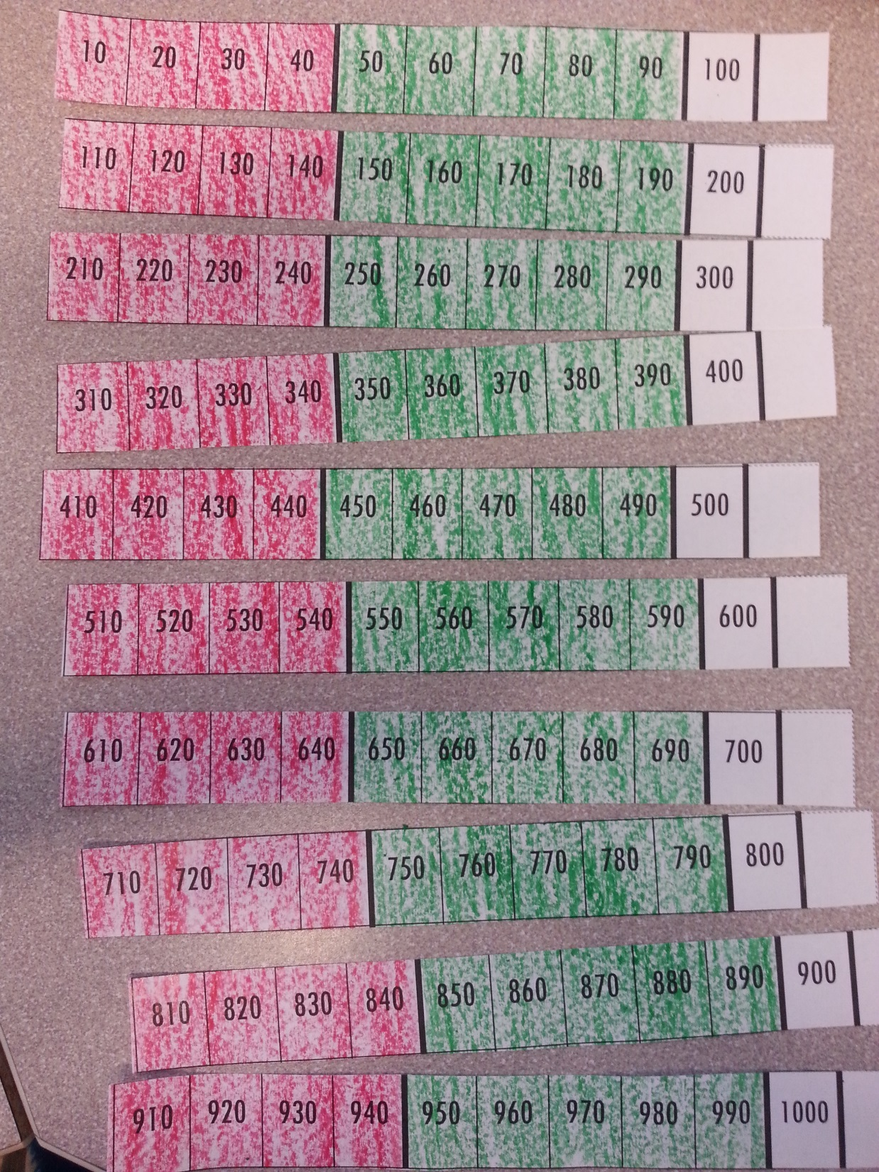
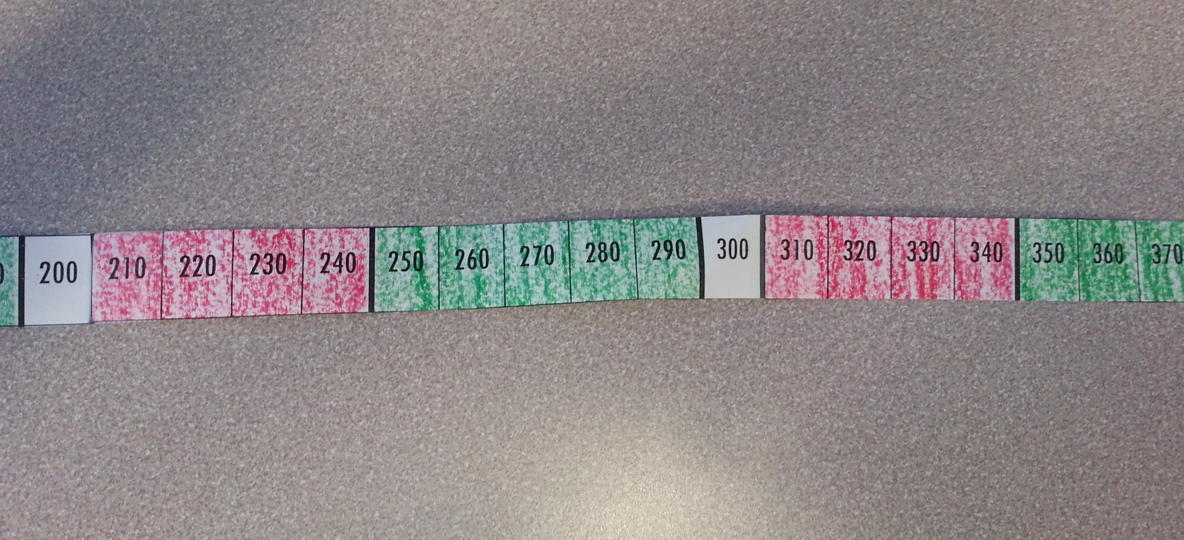
Color the paper as it tells you.
Cut out each ROW.
Glue the rows together to make a number line that counts by tens.

Slide 13
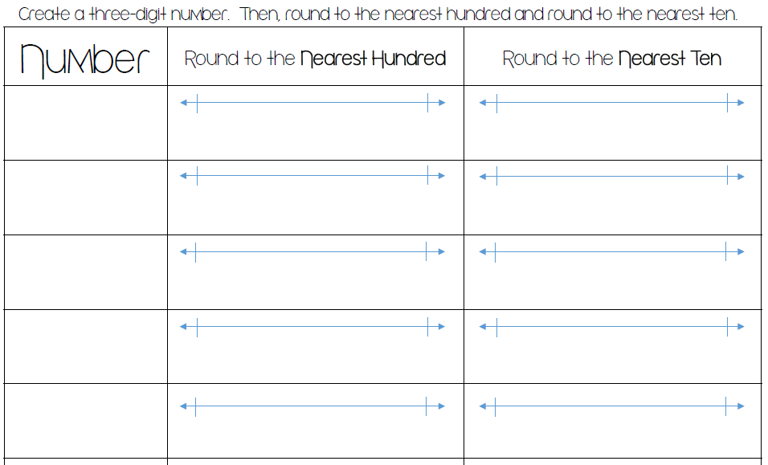
Rounding Game
Take a digit card (1-9)
Find 2 other people and create a three-digit number.
Write that number in the first column.
Then use your rounding tape to round to the nearest hundred.
Then round the same number to the nearest ten.
Find 2 new people, create a new three-digit number and repeat steps 3-5.
459
400
459
500
450
459
460

Slide 14
Exit Ticket Complete the table then answer the question.
 | Rounded to the Nearest Hundred | Rounded to the Nearest Ten
489
492
496
503
505
Which numbers round to the SAME NUMBER when rounded to the nearest HUNDRED and TEN?
489
492
496
503
505

