Slide 1
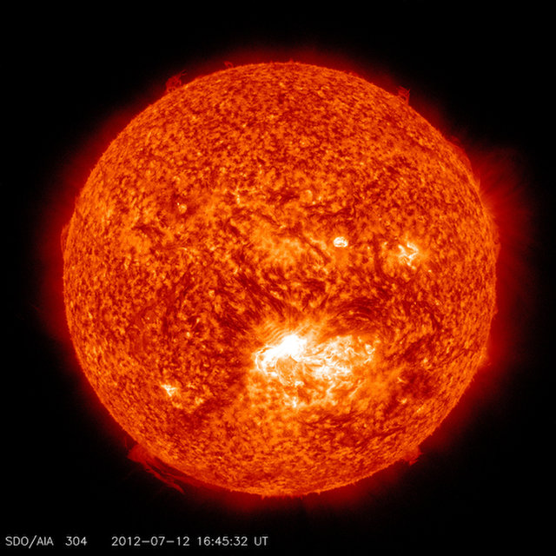
What is Sun?
Sun is a star.
Sun emits energy in the form of light and heat.

Slide 2
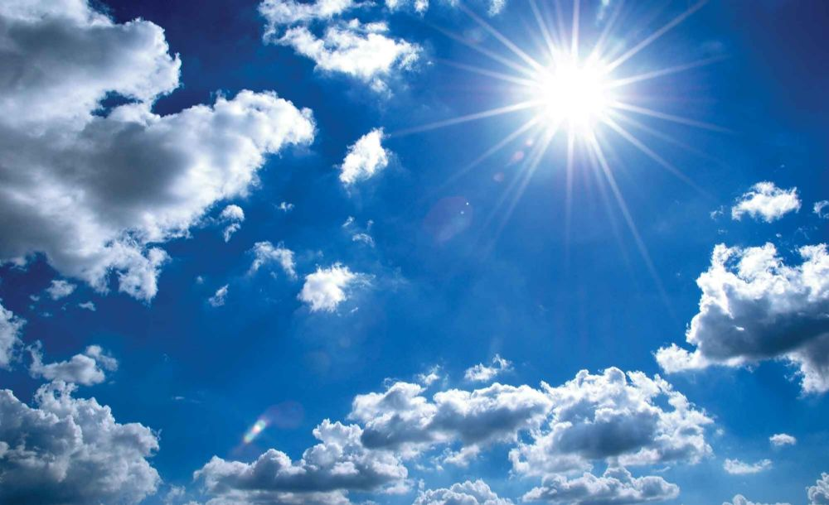
The Sun
Our sun is a medium-size star.
The sun appears much larger than other stars. It also appears much brighter. That is because the sun is much closer to Earth than other stars are.
From Earth, our sun looks like giant ball of light. The sun, like other stars, give off light and heat.

Slide 3
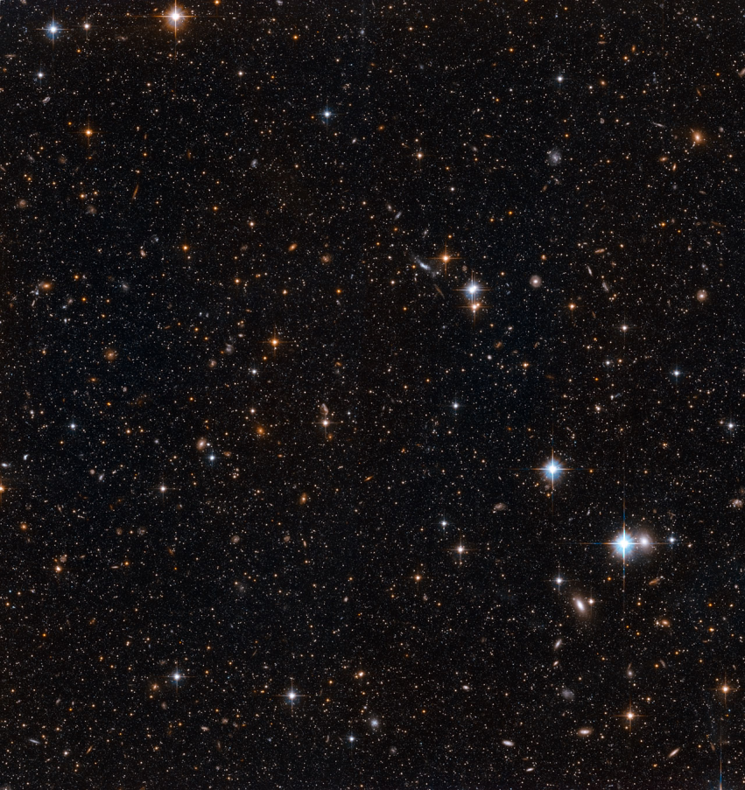
Stars
A star is a ball of hot, glowing gases.
From Earth most stars look like small points of light. This is because they are far away. The sun and other stars are both present in the daytime. You cannot see the other stars because the sun makes the sky so bright.

Slide 4
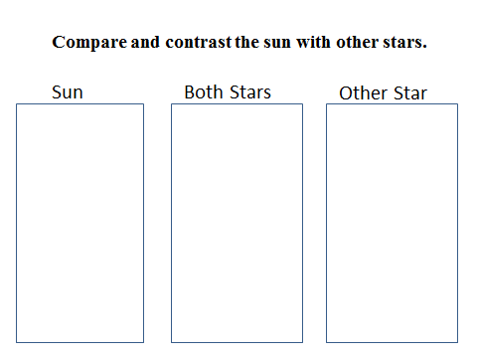

Slide 5
Compare and contrast the sun with other stars.
Sun
Both Stars
Other Star
CcC====
Closer to Earth
Appears very bright
Looks like a giant ball from Earth,
Seen during the day
Give off light and heat
Surfaces similar in appearance,
Are present during the day
Much farther from Earth,
Looks like a small point of light from Earth,
Seen only at night

Slide 6
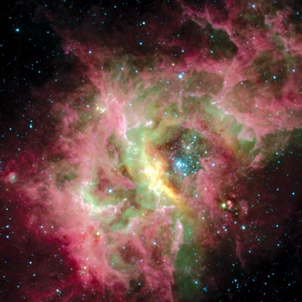
Great balls of Fire
From far away, stars look very similar. Up close, stars have many different characteristics.
How are stars alike?
How are they different?
Stars are born in giant clouds of gas and dust.

Slide 7
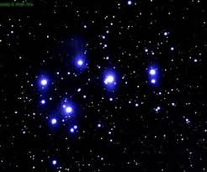
Brightness
Brightness tells us how much light a star gives off.
A very bright star gives off a lot of light.
Some stars are much brighter than our Sun. Others are dimmer.
A star might look bright because it is closer to Earth or because it is bigger and hotter than other stars.

Slide 8
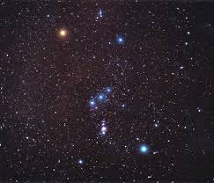
Size
Supergiant stars are the largest stars.
Hundreds of thousands of our sun could fit inside one supergiant star!
The smallest stars are called dwarfs.

Slide 9
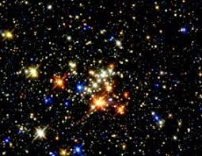
Color
Stars have different colors.
Our sun is a yellow star.
Blue, white, and red are other colors of stars.
Blue stars are the hottest.
Red stars are the coolest.

Slide 10

Comprehension check
Two stars have the same brightness in space, but one star looks brighter from Earth. How is that possible?
Solve a problem: The sun is 100 times as big as Earth. Suppose a star is 5 times as big as the sun. Write a multiplication sentence to show how many times larger this star is than Earth.
Notes:
The star that seems brighter must be nearer Earth that the other star.
5*100=500

Slide 11
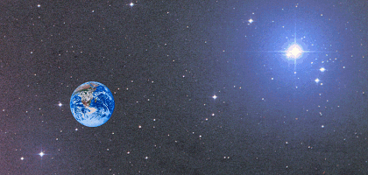
What is the sun?
The sun is a star, a very hot ball of glowing hydrogen gas that gives off light. It looks different than other stars because it is so close to the Earth – only 150,000,000 km away or 93,000,000 miles.
The next nearest star, Proxima Centauri, is 40,000,000,000 km away (40 trillion).

Slide 12
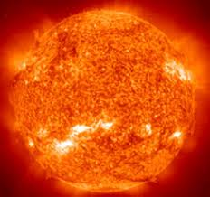
The sun lights Earth
Radiant energy is energy that can travel through space.
Stars give off radiant energy.
The sun is our closest star.
The sun gives off radiant energy, which travels to Earth as light.
The light energy helps people and animals see.

Slide 13
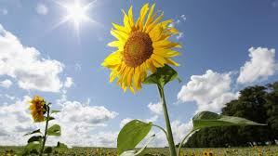
Earth would be a cold, dark, and empty planet without the sun. Life could not survive.
Plants use light energy to make their own food. Without light energy from the sun, there could be no plants on Earth. Without the sun, there would be no plants or animals on Earth.

Slide 14
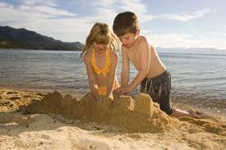
The sun heats Earth
Radiant energy from the sun warms Earth's land, air, and water. During the night, some heat leaves Earth. That is why it is cooler at night than during the day.
You cannot see the sun's energy heating Earth, but you can fell it. When you walk on a beach heated by the sun, the sand feels hot. Without the sun's radiant energy, Earth would be too cold for people to live.

Slide 15
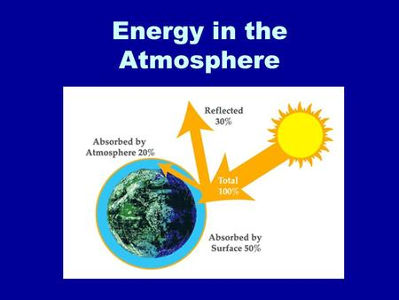

Slide 16
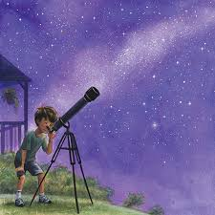
Telescope
Telescope is a tool that makes faraway objects seem larger.
It makes stars look brighter and closer.
Stars that are bright look even brighter. Stars that are dim look brighter, too.

Slide 17
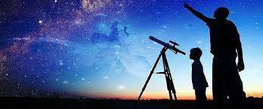
Telescope is a tool for observing distant objects.
Light telescopes use lenses and mirrors to capture light from distant objects in space. Light telescopes collect much more light than you can see with just your eyes. Objects which are too dim for you to see can become visible with a light telescope.

Slide 18

Brain Check
A ball of hot, glowing gases ____________.
The kind of energy from the sun that helps people see __________.
An instrument that makes stars look brighter and closer ___________.
The star that is closest to Earth ________.
The kind of energy that can move through space ___________.
Features of stars are brightness, size, and __________.
Notes:
Star
Light
Telescope
Sun
Radiant
Color

