Slide 1
3rd Graders Favorite Cafeteria Foods

Slide 2
Solve Problems Using Data
Unit: Represent and Interpret Data
MAFS.3.MD.2.3
I can solve problems using data represented in graphs.

Slide 3
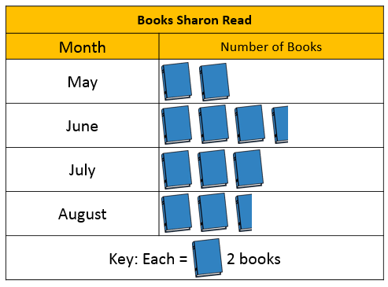
A table or graph has features that can help you interpret the graph.
Title
Title for the labels
Labels
Key (picture graphs only)

Slide 4
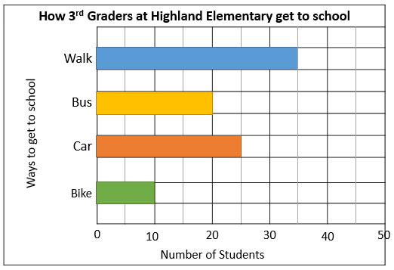
A table or graph has features that can help you interpret the graph.
Title
Title for the labels
Labels
Key (picture graphs only)
Scale (bar graphs only)

Slide 5
Questions to consider… How many in all?
How many books did Sharon read in all?
4
7
6
5
4 + 7 + 6 + 5
= 22
Sharon read 22 books in all.

Slide 6
Questions to consider… How many in all?
How many 3rd Graders are at Highland Elementary?
35
20
25
10
35 + 20 + 25 + 10
= 90
There are 90 3rd graders at Highland Elementary.

Slide 7
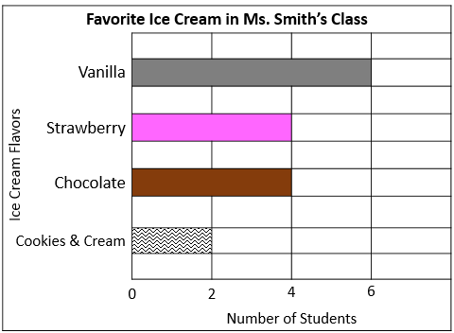
Questions to consider… How many in all?
How many students participated in the survey?
6
4
4
2
6 + 4 + 4 + 2
= 16
16 students participated in the survey.

Slide 8
Questions to consider… How many more or less?
When you compare data, you find the difference between the data.
How many more…
or
How many less…
or
How many fewer…
are COMPARISON questions

Slide 9
Questions to consider… How many more or less?
How many fewer books did Sharon read in August than June?
7
7 – 5
= 2
5
5 + _ = 7
Sharon read 2 fewer books in August than in June.

Slide 10
Questions to consider… How many more or less?
How many more students walk to school than bike and ride the bus together?
35
20
30
35 – 30
= 5
10
30 + _ = 35
5 more students walk than bike and ride the bus.

Slide 11
Questions to consider… How many more or less?
How many less students like the least popular ice cream flavor than the most popular ice cream flavor?
6
6 – 2
= 4
2
2 + _ = 6
4 less students like the least popular ice cream flavor than the most popular ice cream flavor.

Slide 12
Other questions to consider…
What if….
or
Use the clues to complete the graph

Slide 13
Questions to consider… What if…?
What if Sharon read
3 more books in May?
How many book symbols would there be for May?
2
2
2
1
If Sharon read 3 more books in May, May would have 3 and a half book symbols.

Slide 14
Questions to consider… Use clues to complete the graph.
Clues
There were 4 pink balloons at Miriam’s Party.
There were 5 orange balloons at Miriam’s party.
There were 20 balloons altogether.
Balloons at Miriam’s Party
Green
Pink
Yellow
Orange
= 9
_ + _ = 4
= 5
What does each balloon symbol represent?
How many balloon symbols should there be for yellow?
KEY
= ? balloons
Each balloon symbol represents 2 balloons.
2
9 + 4 + __ + 5 = 20
There should be 1 balloon symbol for yellow.

Slide 15
Wrap-Up
How can you solve problems using data represented in graphs? What can help you interpret a graph?
Notes:
At this time, you can also review some of the “trickier” problems from the students’ ‘You Do’ work either from the book or the Enrich pages of the unit. (Enrich 2.3, 2.4 and 2.6 offer great opportunities to use clues to create graphs.)

