Slide 1
Solve Addition & Subtraction Problems Involving Liquid & Mass
MAFS.3.MD.1.2

Slide 2
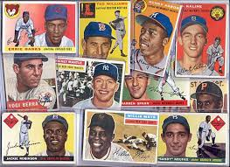
Lesson Opening
Solve the following problem.
Tom has 114 baseball cards. He gave away 75 to his friend. How many baseball cards does Tom have left?

Slide 3
Lesson Opening
Solve the following problem.
Tom has 114 baseball cards. He gave away 75 to his friend. How many baseball cards does Tom have left?
75 + 5 = 80
80 + 20 = 100
100 + 14 = 114
Tom has 39 baseball cards left.
20 + 14 + 5 = 39

Slide 4
Solving problems about liquid volume and mass is similar. Instead of baseball cards, you may be subtracting kilograms or liters!
Tom has 114 baseball cards. He gave away 75 to his friend. How many baseball cards does Tom have left?
75 + 5 = 80
80 + 20 = 100
100 + 14 = 114
Tom has 39 baseball cards left.
20 + 14 + 5 = 39

Slide 5
Solving problems about liquid volume and mass is similar. Instead of baseball cards, you may be subtracting kilograms or liters!
Let’s try one!
A pitcher holds 500 mL of lemonade. After you pour a glass there is 325 mL left in the pitcher. How much lemonade did you pour into your glass?
325 + 75 = 400
400 + 100 = 500
You poured 175 mL into your glass.
75 + 100 = 175

Slide 6
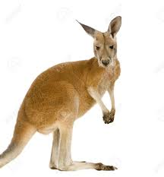
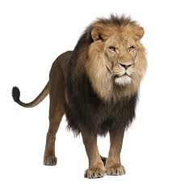
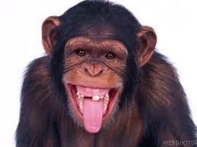
Let’s try another one…
A zoo keeper was moving some of his animals to a new location. The zoo keeper needed to find the combined weight of the animals he wanted to move. The kangaroo weighs 39 kilograms. The lion weighs 126 kilograms. The chimpanzee weighs 47 kilograms. What is the combined mass, in kilograms, of the animals?
86 + 126
39 + 47
+1
-1
6 + 6 = 12
80 + 20 = 100
100 + 0 = 100
40 + 46 = 86
212
The combined mass is 212 kilograms.

Slide 7
Your Turn
Gallery Walk
Solve the problems around the room. Use the recording sheet to show your work.

Slide 8
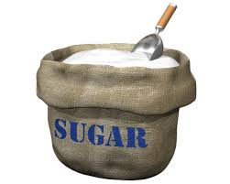
Exit Ticket
Pedro had some sugar in a bag. He added another 248g of sugar to the bag which gave him a total of 332g of sugar. How much sugar did Pedro have to begin with?

