Slide 1
Reading and Using a Scale
MAFS.3.MD.1.2

Slide 2
Lesson Opening – Write the number that each star represents.
10
15
2
1
20
70
80
90
3
100
4
120
10
5
20
6
30

Slide 3
Lesson Opening – Write the number that each star represents.
Think: What can I count by on the number line? Try 1s, then 2s, 5s, or 10s until you find one that works.
10
11
12
14
15
16
17
2
19
1
18
20
13
70
75
80
85
90
3
100
105
4
115
120
95
110
10
12
14
16
5
20
22
24
6
28
30
18
26

Slide 4
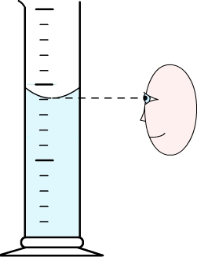
Can I use this same skill to name numbers on a scale?
15
I need to find out how much water is in this graduated cylinder.
10
10
The red line is where I need to read the graduated cylinder.
9
8
7
I can count by 1s to see if that is what each tick mark represents.
6
5
Counting by 1s worked! So, how much water is in the graduated cylinder?
9 mL
mL

Slide 5
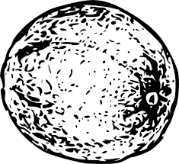
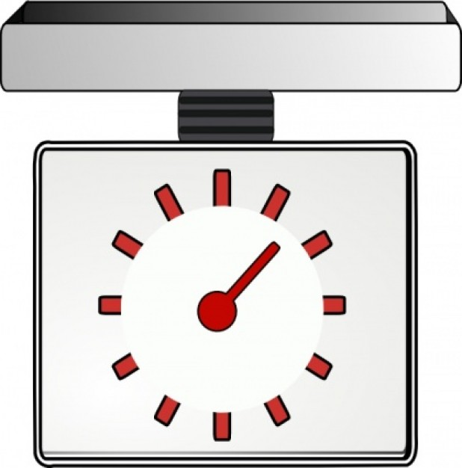
Can I use this same skill to name numbers on a scale?
I need to find out how the mass of the melon.
I can count by 1s to see if that is what each tick mark represents.
Counting by 1s did NOT work! So, let’s try counting by 2s.
0
1
2
18
6
3
12
Kg

Slide 6
Can I use this same skill to name numbers on a scale?
I need to find out how the mass of the melon.
I can count by 1s to see if that is what each tick mark represents.
Counting by 1s did NOT work! So, let’s try counting by 2s.
0
Counting by 2s did work! So, where is the needle?
2
4
18
6
6
Between the 2 and 4.
3
What number is in between 2 and 4?
12
Kg
The melon has a mass of 3 kg.

Slide 7
Can I use this same skill to name numbers on a scale?
mL
50
I need to find out how many milliliters of liquid is in this graduated cylinder.
40
35
What can we count by for each tick mark?
30
30
25
There are 35 mL of liquid in the graduated cylinder.
20
20
15
10
10
5

Slide 8
Your Turn
Complete the Practice Pages.

Slide 9
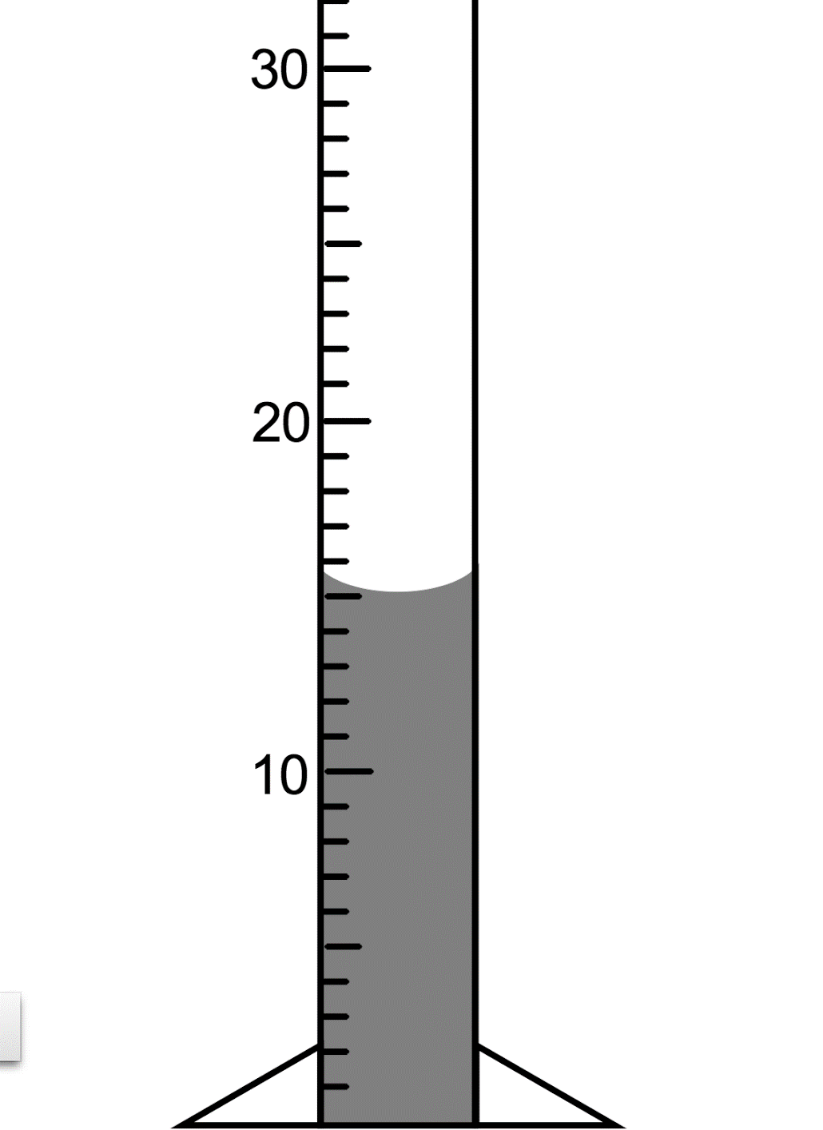
Exit Ticket
How many milliliters of liquid is in the graduated cylinder?
mL

