Slide 1
Problems of the Day
Unit 5: Area

Slide 2
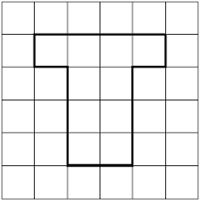
Lesson 1 - 11.4: Understand Area
What are the areas of the two shapes below?
Describe a situation in which you would need to know the area of a space.
MAFS.3.MD.3.5

Slide 3
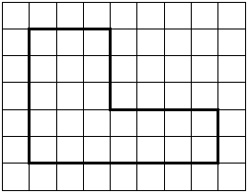
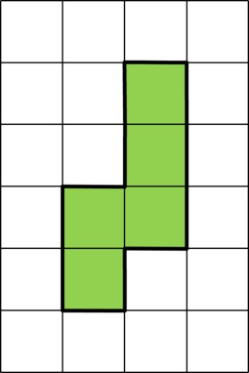
Lesson 2 - 11.5: Measure Area
What are the areas of the two shapes below?
= 1 square unit
MAFS.3.MD.3.6

Slide 4
Lesson 3 - 11.6: Use Area Models
Which expressions could you use to find the area of the shape below? (Choose all that apply.)
8 + 3 + 8 + 3
8 + 8 + 8
8 x 8 x 8
(3 x 5) + (3 x 3)
3 + 3 + 3 + 3 + 3 + 3 + 3 + 3
8 x 3
MAFS.3.MD.3.7

Slide 5
Lesson 4 - Supplement: Relate Area to Multiplication and Division
What could the dimensions of a rectangle be that has DOUBLE the area of the rectangle below?
3 feet
3 feet
MAFS.3.MD.3.7

