Slide 1
Organize Data
Unit: Represent and Interpret Data
MAFS.3.MD.2.3
I can organize data in a table to help me solve problems.

Slide 2
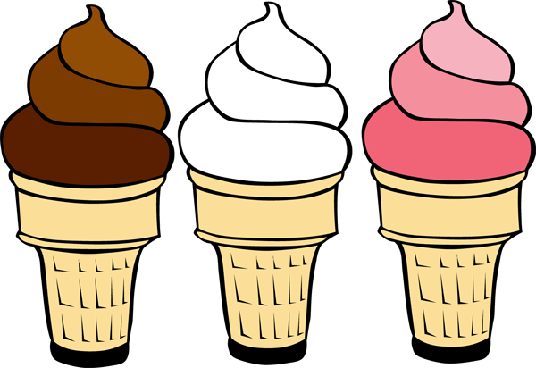
If you wanted to know what kind of ice cream you should buy for a class party, what would be more useful to you?

Slide 3
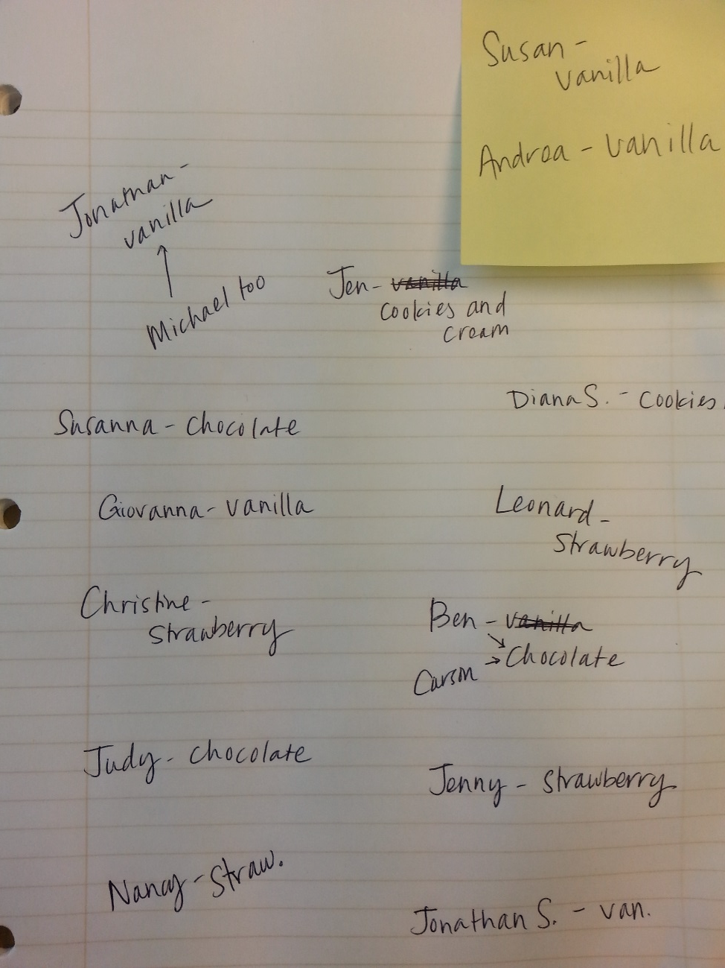
Favorite Ice Cream
Ice Cream Flavor | How Many Votes
Vanilla | 6
Strawberry | 4
Chocolate | 4
Cookies and Cream | 2
OR

Slide 4
A tally table and a frequency table are similar.
How are they alike?
How are they different?
Which one is easier to read?
Favorite Ice Cream
Ice Cream Flavor | How Many Votes
Vanilla | llll l
Strawberry | llll
Chocolate | llll
Cookies and Cream | ll
Favorite Ice Cream
Ice Cream Flavor | How Many Votes
Vanilla | 6
Strawberry | 4
Chocolate | 4
Cookies and Cream | 2
Tally Table
Frequency Table

Slide 5
Both tables allow you to make observations about the data, or information.
Favorite Ice Cream
Ice Cream Flavor | How Many Votes
Vanilla | llll l
Strawberry | llll
Chocolate | llll
Cookies and Cream | ll
Favorite Ice Cream
Ice Cream Flavor | How Many Votes
Vanilla | 6
Strawberry | 4
Chocolate | 4
Cookies and Cream | 2
Tally Table
Frequency Table

Slide 6
Which ice cream flavor is the most popular?
Which ice cream flavor is the least popular?
How many more students like vanilla than chocolate?
Favorite Ice Cream
Ice Cream Flavor | How Many Votes
Vanilla | llll l
Strawberry | llll
Chocolate | llll
Cookies and Cream | ll
Favorite Ice Cream
Ice Cream Flavor | How Many Votes
Vanilla | 6
Strawberry | 4
Chocolate | 4
Cookies and Cream | 2
Tally Table
Frequency Table

Slide 7
So, what kind of ice cream should we buy?
Favorite Ice Cream
Ice Cream Flavor | How Many Votes
Vanilla | 6
Strawberry | 4
Chocolate | 4
Cookies and Cream | 2

Slide 8
Let’s look at some different data…
What is the most popular color?
How many people like red and green?
How many people voted in the survey?
Kind of hard to tell without first putting the data into a table, huh?

Slide 9
Let’s put the data into the frequency table…
Favorite Colors in our Class
Color
Number of People
Red
6
Blue
6
Green
3
Yellow
3

Slide 10
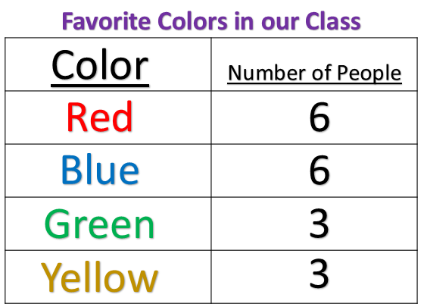
Now, we can answer those questions more easily…
What is the most popular color?
How many people like red and green?
How many people voted in the survey?
red and blue
6 + 3 = 9
6 + 6 + 3 + 3 = 18

Slide 11
What else do you notice about the data?
If one more person voted for red or blue, that color would be the most popular.
The same number of people voted for red AND green as the number of people who voted for blue AND yellow.
3 fewer people voted for green than blue.
3 more people voted for red than yellow.
What else?

Slide 12
Choose a question you would like to ask your classmates.
What is your favorite cafeteria lunch?
How do you get to school?
What is your favorite brand of sneakers?
How many pets do you have?
What is your favorite pizza topping?
How many siblings do you have?
Or, any other question that your teacher approves

Slide 13
Give your tables a title, label each side of the table, and write the choices on the left side of the table.
TITLE
LABEL | LABEL (usually NUMBER OF STUDENTS)
Choice 1
Choice 2
Choice 3
Choice 3
Once you have completed your tally table and turned it into a frequency table,
write 3 observations about your data.

Slide 14
Wrap-Up
Ice Cream Flavor | How Many Votes
Vanilla | 6
Strawberry | 4
Chocolate | 4
Cookies and Cream | 2
Which one is easier to use to make decisions about the data? Why?
OR

Slide 15
Wrap-Up
Which one is easier to use to make decisions about the data? Why?
What is the difference between a tally table and a frequency table?
Can you turn a tally table into a frequency table? Why would you want to do that?
Why is it important to organize our data into tables?
How can you find out how many people participated in a survey?

