Slide 1
Finding the Area of Complex Shapes
MAFS.3.MD.3.7d

Slide 2
Lesson Opening
What is the area of the rectangle below?
12 feet
4 × 12
= 48 square feet
4 feet

Slide 3
We can also use the Distributive Property to find the area of this rectangle.
What is the area of the rectangle below?
12 feet
10 feet
2 feet
4 × 10
4 × 2
4 feet
(4 × 10) + (4 × 2)
40 + 8 = 48 square feet

Slide 4
What if you have a shape like this and you want to find the area?
Decompose the shape into
non-overlapping rectangles.
3 cm
5 cm
Find the area of each rectangle.
8 × 3 = 24
Add the areas of each rectangle.
8 cm
3 cm
3 × 3 = 9
24 + 9 = 33 square cm
3 cm
6 cm

Slide 5
Let’s try one together…
1. Decompose the shape into
non-overlapping rectangles.
6 in
2. Find the area of each rectangle.
4 in
3. Add the areas of each rectangle.
6 × 6 = 36
6 in
1 in
36 + 2 = 38 square in
2 in
1 × 2 = 2
7 in

Slide 6
Let’s try another one…
1. Decompose the shape into
non-overlapping rectangles.
2 in
2 × 2 = 4
2 in
2 in
2 in
2. Find the area of each rectangle.
3. Add the areas of each rectangle.
4 × 6 = 24
4 in
24 + 4 = 28 square in
6 in

Slide 7
Your Turn on dry-erase boards
Decompose the shape into
non-overlapping rectangles.
Find the area of each rectangle.
Add the areas of each rectangle.
3 in
3 × 4 = 12
10 × 5 = 50
12 + 50 = 62 square inches
4 in
9 in
7 in
5 in
10 in

Slide 8
Your Turn on dry-erase boards
Decompose the shape into
non-overlapping rectangles.
Find the area of each rectangle.
Add the areas of each rectangle.
3 × 4 = 12
10 × 5 = 50
12 + 50 = 62 square inches
3 in
4 in
9 in
7 in
OR
5 in
3 × 9 = 27
7 × 5 = 35
27 + 35 = 62 square inches
10 in

Slide 9
Your Turn on dry-erase boards
Decompose the shape into
non-overlapping rectangles.
Find the area of each rectangle.
Add the areas of each rectangle.
3 m
3 × 3 = 9
7 × 5 = 35
9 + 35 = 44 square meters
3 m
3 m
1 m
5 m
7 m

Slide 10
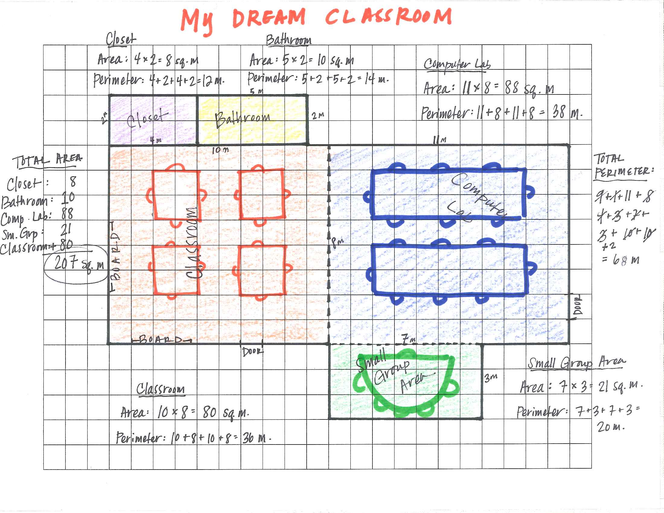
Your Turn – Create your dream classroom Floor Plan
Create your DREAM classroom
Follow the requirements on the Requirement List
Use grid paper
Don’t forget to find the AREA and PERIMETER for each part of your classroom

Slide 11
The following pictures are examples of real floor plans.

Slide 13
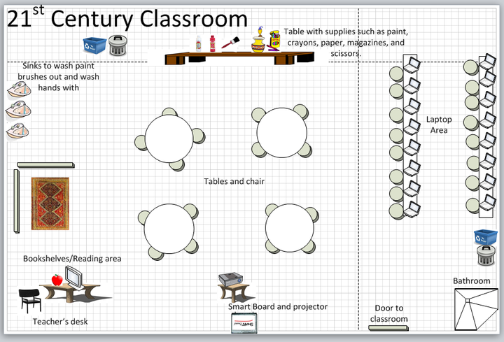

Slide 14
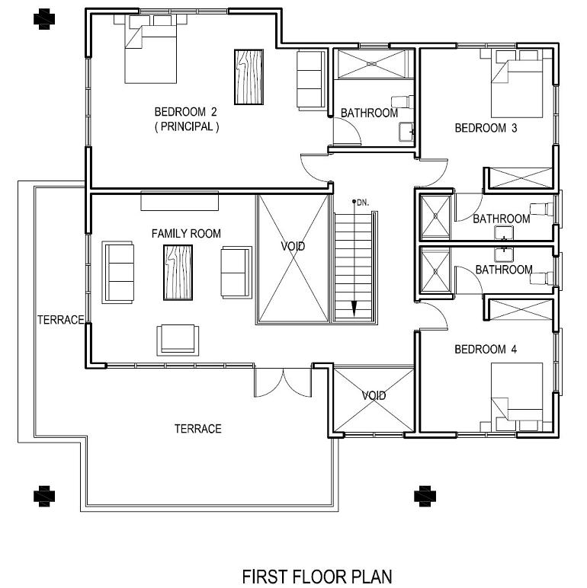

Slide 15
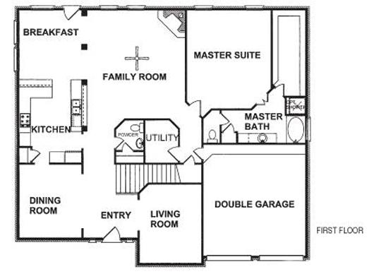

Slide 17
Exit Ticket (slide 1 of 2)
What is the area of the figure below?
12 yards
4 yards
7 yards
9 yards
3 yards
3 yards

Slide 18
Exit Ticket (slide 2 of 2)
Select all the expressions that can be used to find the area of the rectangle below.
13 x 3
3 x 13
3 x (10 + 3)
(3 x 9) + (3 x 3)
(3 x 10) + (3 x 3)
13 units
3 units

