Slide 1
Find Perimeter
MAFS.3.MD.4.8

Slide 2
Lesson Opening
18 units
What is the perimeter of the quadrilateral below?
1
2
3
4
18
5
17
6
16
7
15
8
14
9
13
12
11
10

Slide 3
Lesson Opening
18 units
What is the perimeter of the quadrilateral below?
1
2
3
4
Is there another way to find the perimeter?
18
5
17
6
16
7
Add the length of each side.
15
8
14
9
13
12
11
10

Slide 4
If there are 4 sides to the shape, there should be 4 addends to find the perimeter.
5 + 4 + 5 + 4 = 18
18 units
What is the perimeter of the quadrilateral below?
4 units
Is there another way to find the perimeter?
5 units
5 units
Add the length of each side.
4 units

Slide 5
Add side lengths to find perimeter.
What is the perimeter of the triangle?
8 inches
8 + 9 + 11 =
28 inches
9 inches
11 inches
If there are 3 sides to the shape, there should be 3 addends to find the perimeter.

Slide 6
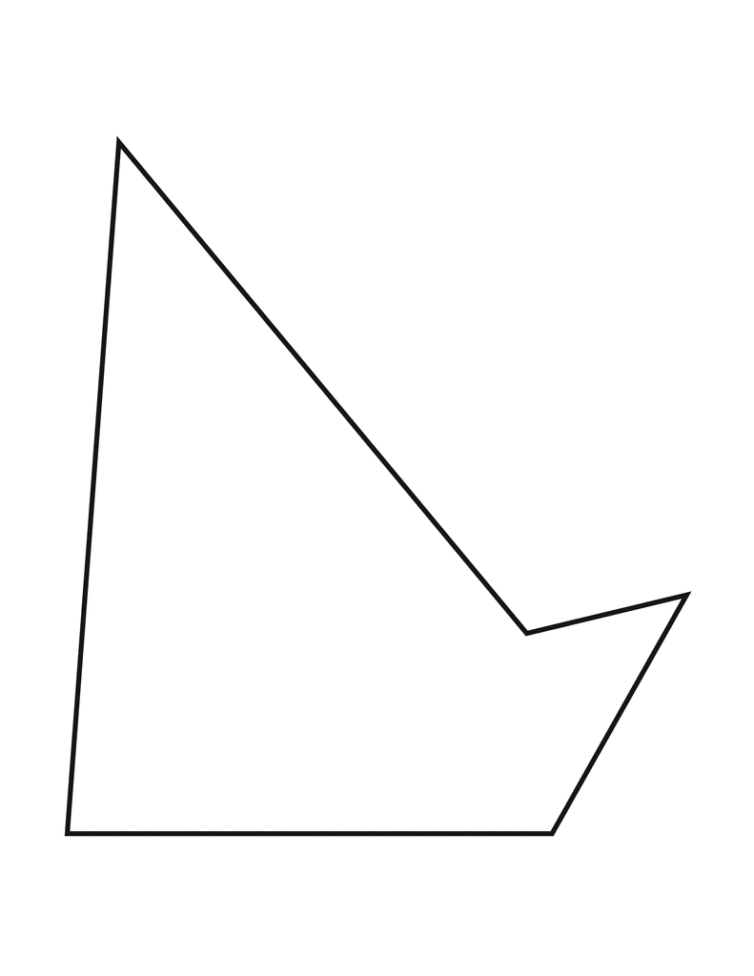
Add side lengths to find perimeter.
What is the perimeter of the pentagon?
12 + 8 + 1 + 3 + 7 =
31 feet
8 feet
12 feet
1 foot
3 feet
If there are 5 sides to the shape, there should be 5 addends to find the perimeter.
7 feet

Slide 7
Add side lengths to find perimeter.
What is the perimeter of the rectangle?
If this is…
8 inches
If this is…
8 + 4 =
12 inches?
because this is a rectangle
Then this side is
4 inches, too!
4 inches
Then this side is 8 inches, too!
If there are 4 sides to the shape, there should be 4 addends to find the perimeter.
So, where are the other addends?

Slide 8
Add side lengths to find perimeter.
What is the perimeter of the rectangle?
If this is…
8 inches
If this is…
8 + 4
+ 8 + 4
because this is a rectangle
Then this side is
4 inches, too!
4 inches
= 24 inches
Then this side is 8 inches, too!
If there are 4 sides to the shape, there should be 4 addends to find the perimeter.
So, where are the other addends?

Slide 9
Add side lengths to find perimeter.
What is the perimeter of the regular hexagon? (Regular means that all the sides are the SAME length.)
3 cm
3 + 3 + 3 + 3 + 3 + 3 =
Or, 6 × 3 =
18 cm
If there are 6 sides to the shape, there should be 6 addends to find the perimeter.

Slide 10
What if you don’t have a picture, you have a word problem instead?
Turn & Talk: What does this have to do with perimeter?
Miguel glues a ribbon border around the edges of a 5-inch by 8-inch picture to create a frame. What is the total length of ribbon Miguel uses?
Draw a picture to help you.
5 inches
5
+ 8
+ 5
+ 8
= 26 inches
8 inches
The total length of ribbon Miguel uses is 26 inches long.

Slide 11
What if you don’t have a picture, you have a word problem instead?
Draw a picture to help you.
A building at Harvard University has a room shaped like an octagon. The length of each side of the room is 11 feet. What is the perimeter of this room?
11 ft
11
× 8
= 88 feet
The perimeter of the room is 88 feet.

Slide 12
Your Turn
Complete the selected problems from the Practice Pages.

Slide 13
Exit Ticket
What is the perimeter of the rectangle?
Manny fences in a rectangular area for his dog to play in the backyard. The area measures 10 yards by 9 yards. What is the total length of fence that Manny uses?
14 inches
6 inches

