Slide 1
Grade 3: Unit 9 Compare Fractions
Making Connections to the FSQ and USA

Slide 2
Which statement correctly compares the two fractions?
3 3
6 8
1 3
4 4
2 2
4 3
5 4
6 6
=
<
>
<

Slide 3
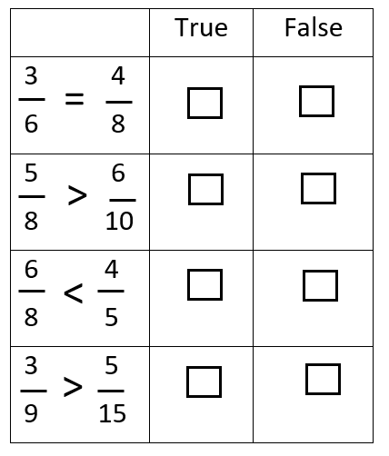
Determine if each set of fractions is compared correctly. Mark True or false in each row.
A
B
6
5
C
D
4
E
F
G
H
15

Slide 4
Which list shows the fractions in order from least to greatest?
1, 1, 1, 1, 1
6 5 4 3 2
1, 1, 1, 1, 1
4 2 3 5 6
1, 1, 1, 1, 1
2 3 4 5 6
1, 1, 1, 1, 1
3 6 2 4 5

Slide 5
Which fraction is greater than but less than
2
6
5
6
1
6
2
6
C. 3
6
D. 5
6

Slide 6
The track team was practicing Monday after school. Susanna ran of a mile, Christine ran of mile, and Jen ran . Who ran the greatest distance?
1
6
1
4
1
8
Susanna
Christine
Jen
They all ran the same distance.

Slide 7
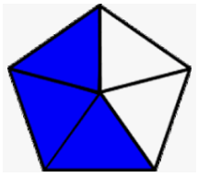
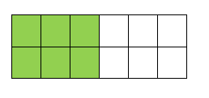
Which model below shows 1/3 shaded?
A.
B.
C.
D.

Slide 8
Which statement correctly compares the shaded parts of the models below?
A. 3 1
2 2
B. 3 1
6 2
C. 3 1
3 1
D. 3 1
6 6
<
=
>
<

Slide 9
Select all the fractions that correctly names the shaded part of the model below.
1/2
4/8
3/4
4/4
2/4

Slide 10
Which statement below is true based on the information provided by the number line?
0
1
A. 3/6 is greater than 2/4.
B. 3/6 is less than 2/4.
C. 3/6 is equal to 2/4.
D. None of the above are true.

