Slide 1
Liquid Volume: Liters and Milliliters
MAFS.3.MD.1.2

Slide 2
Lesson Opening
If you were very thirsty (like you just came back from P.E.) would you rather have…
one LITER of water
or
one MILLILITER of water?

Slide 3
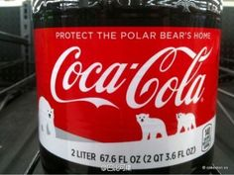
Liquid Volume
Liquid Volume is the amount of liquid in a container.
Many containers that hold liquids have a label that tells you how much liquid volume there is.

Slide 4
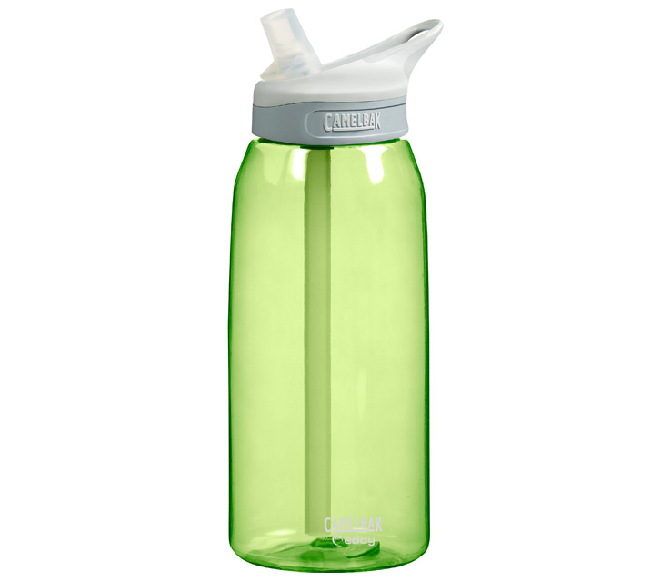
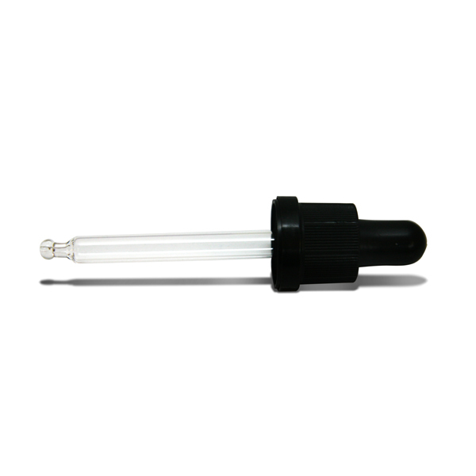
Liter vs. Milliliter
Holds a few milliliters
Holds a liter

Slide 5
So…
If you were very thirsty (like you just came back from P.E.) would you rather have…
one LITER of water
or
one MILLILITER of water?

Slide 6
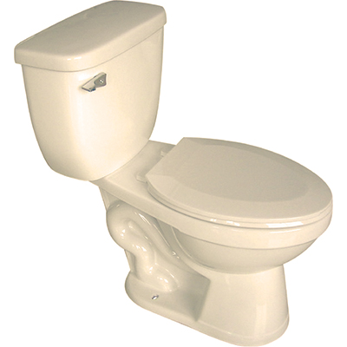
Some Fun Facts
When you flush a toilet, you use about 12 liters of water.

Slide 7
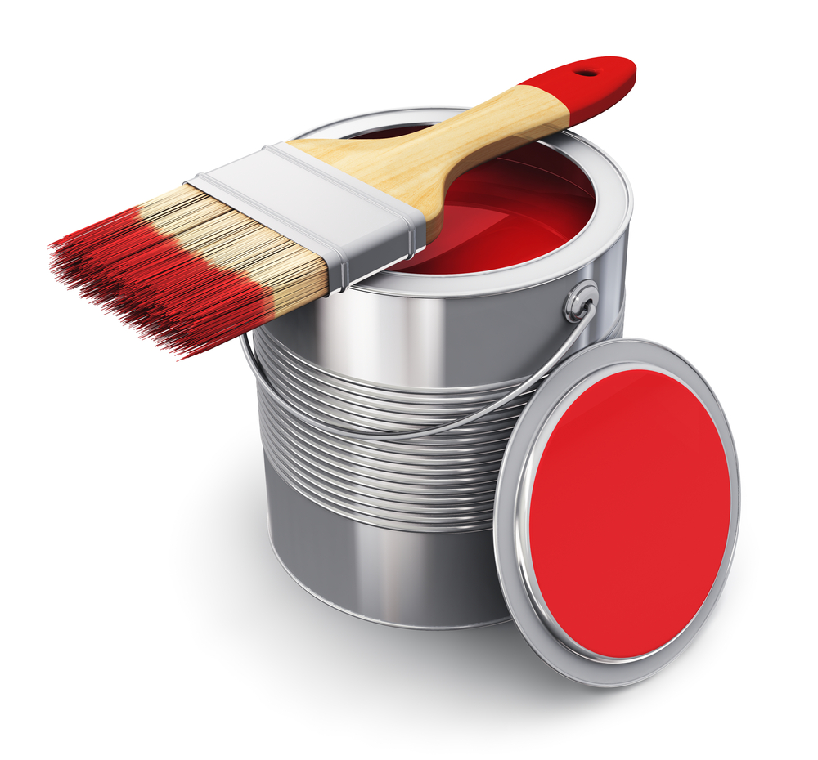
Some Fun Facts
A can of paint holds about 4 liters of paint.

Slide 8
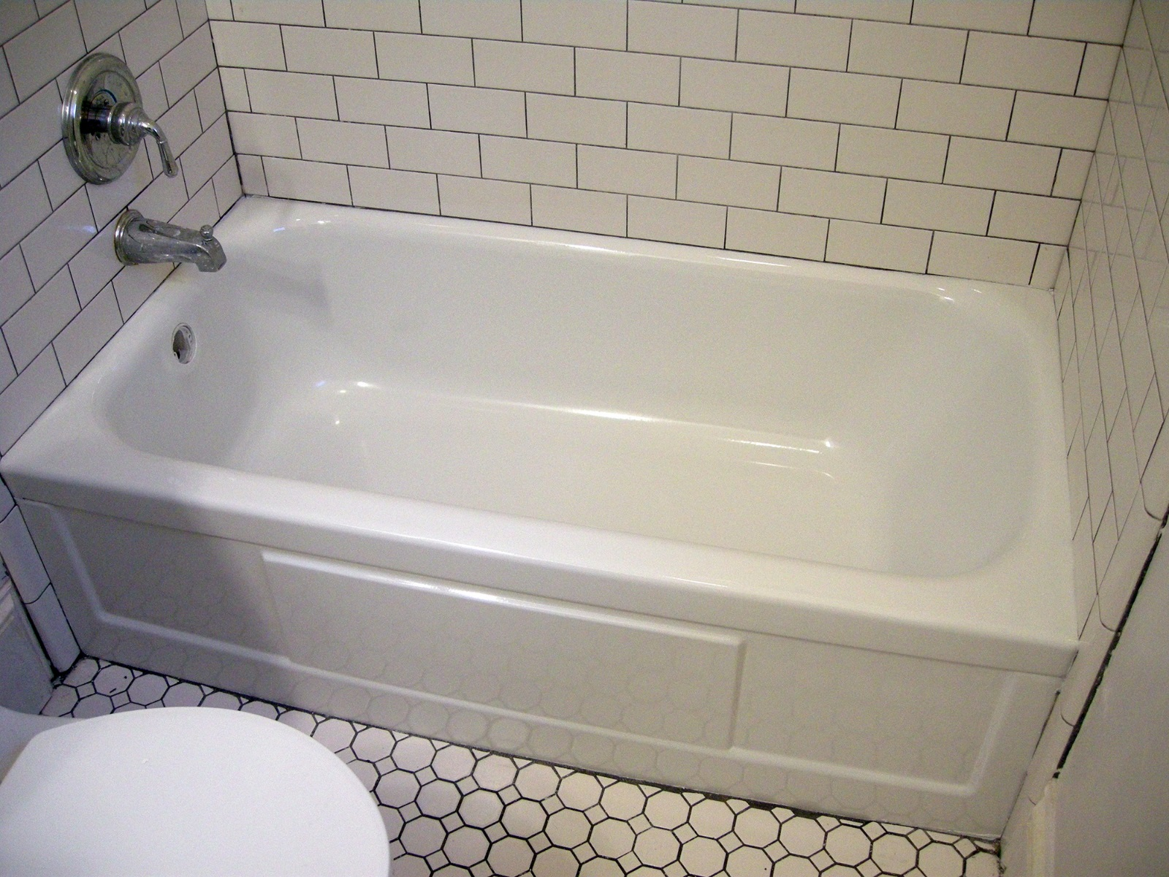
Some Fun Facts
A bathtub holds about 140 liters of water.

Slide 9
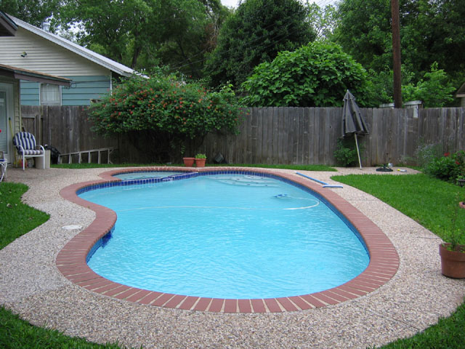
Some Fun Facts
A backyard pool holds about 50,000 liters of water.

Slide 10
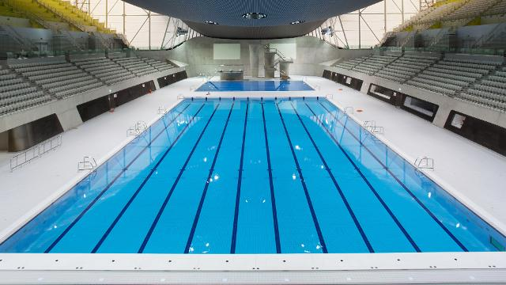
Some Fun Facts
An Olympic-sized pool holds about 2,500,000 liters of water.

Slide 11
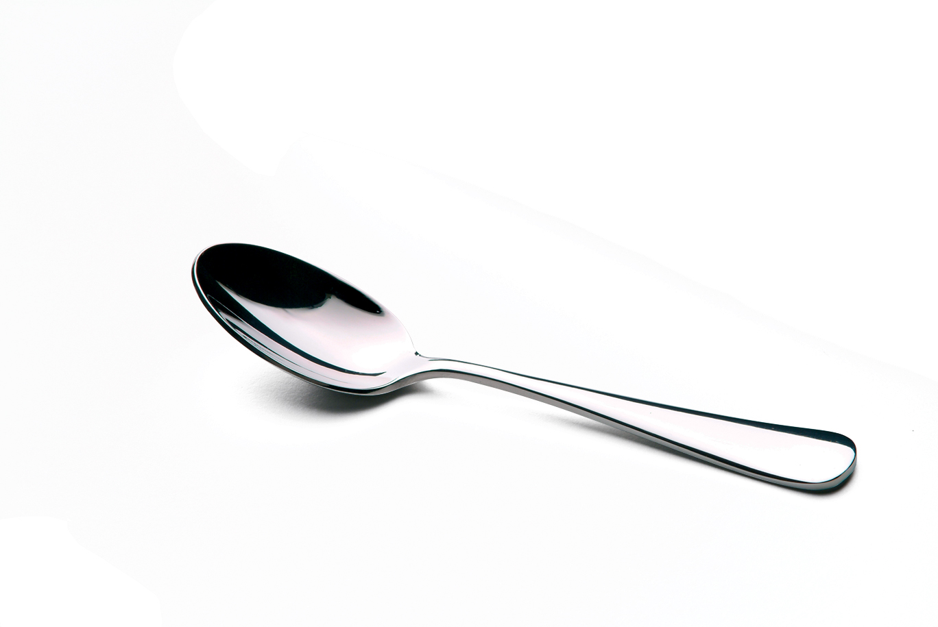
Some Fun Facts
A teaspoon holds about 4 milliliters of water.

Slide 12
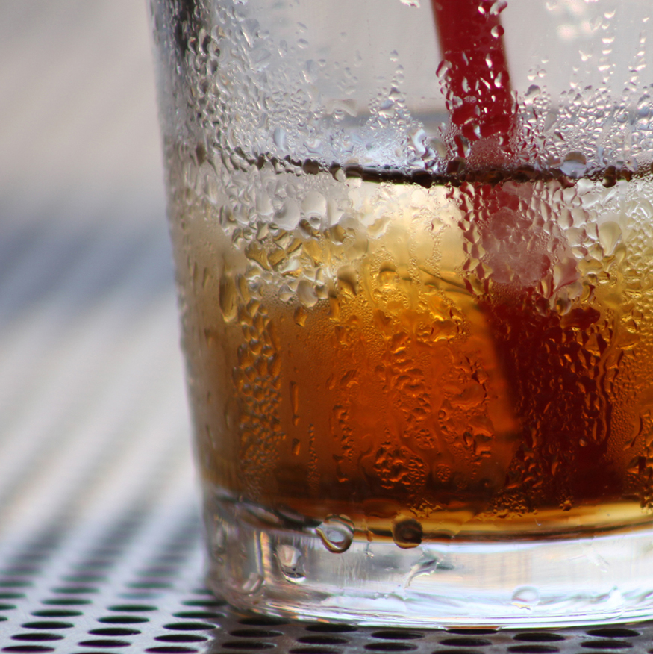
Some Fun Facts
The condensation from a cold glass makes about 1 milliliter of liquid.

Slide 13
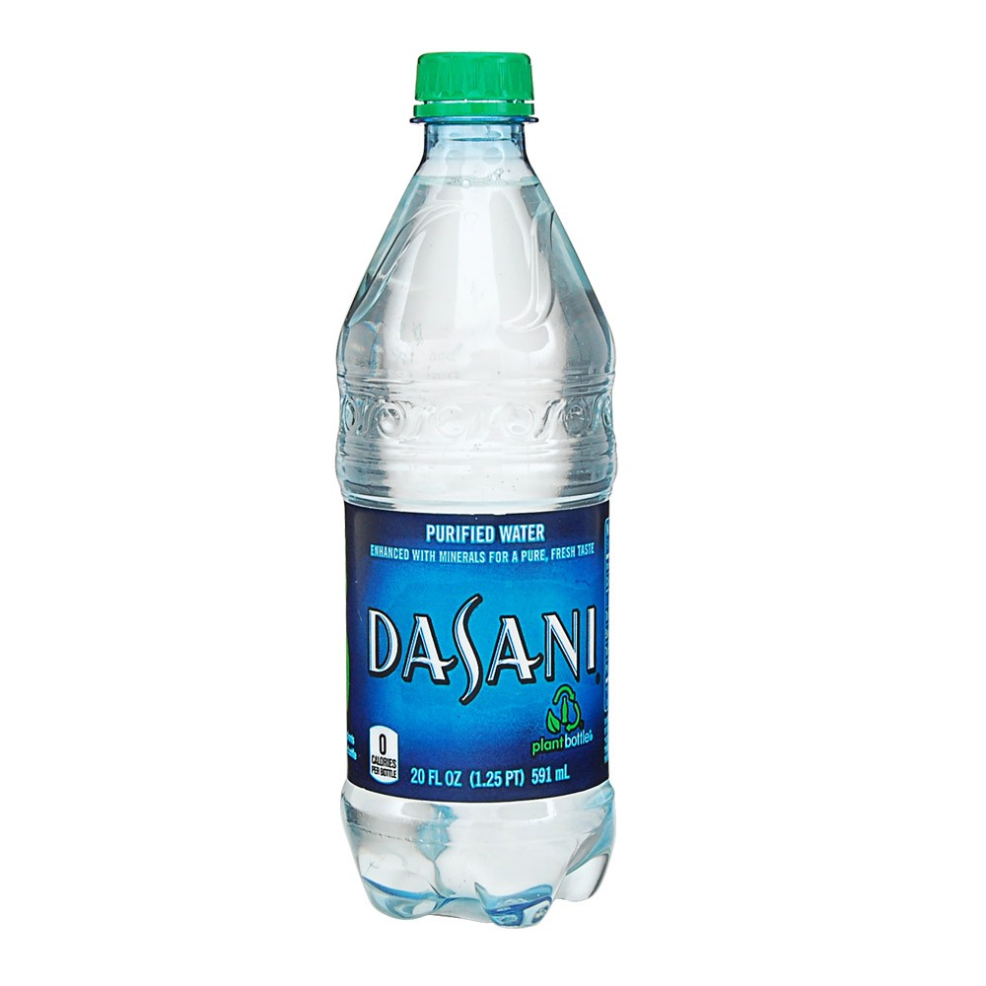
Some Fun Facts
This water bottle holds 591 milliliters of water.

Slide 14
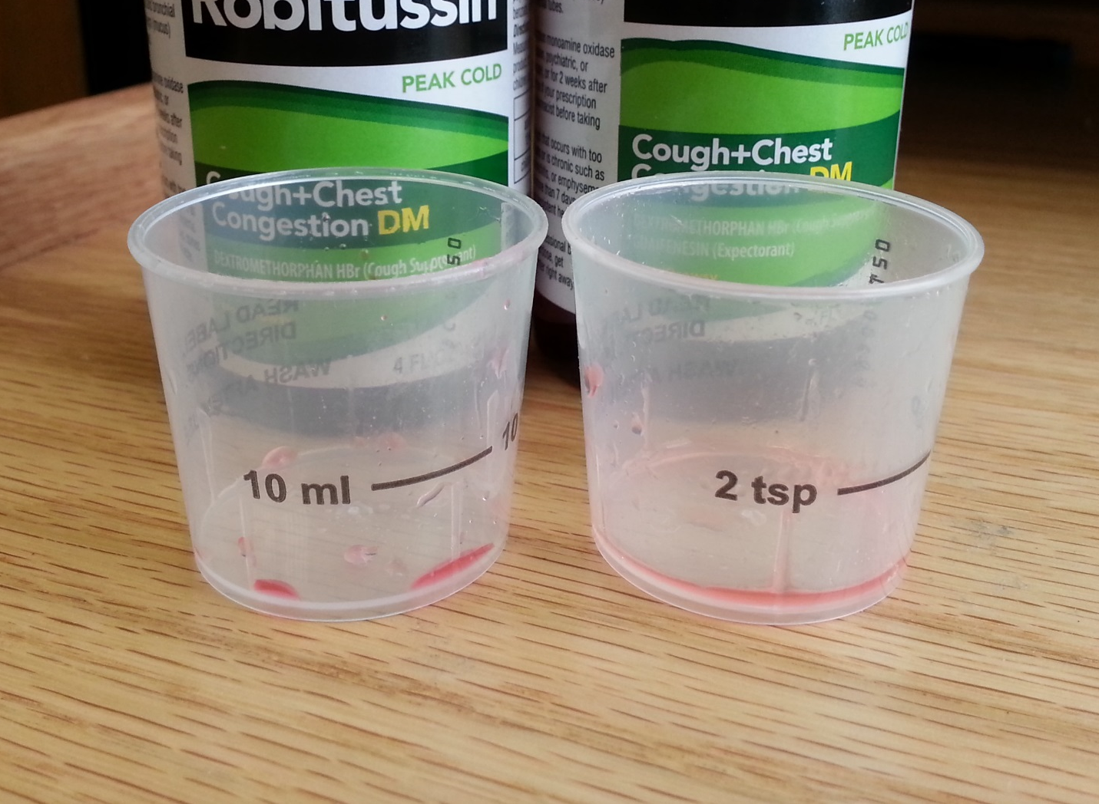
Some Fun Facts
The medicine cup shows 10 milliliters at the line shown.

Slide 15
Your Turn
Put your containers in order from SMALLEST capacity (how much liquid volume would fit in the container) to LARGEST capacity.
When your teacher tells you to, take off the tape from the container to see if you were correct.

Slide 16
Your Turn – Estimation Game
Write LITER on one card
Write MILLILITER on another card
Hold up whether you would measure the liquid volume of the container or object shown in LITERS or MILLILITERS

Slide 17
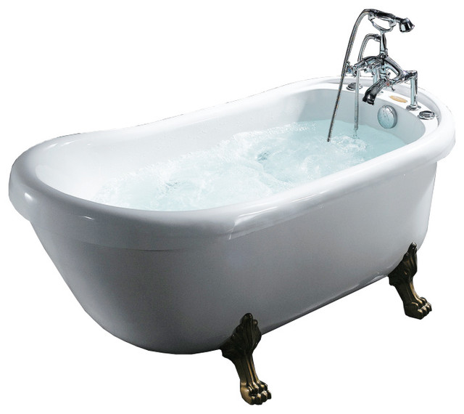
Estimation Game
Bathtub

Slide 18
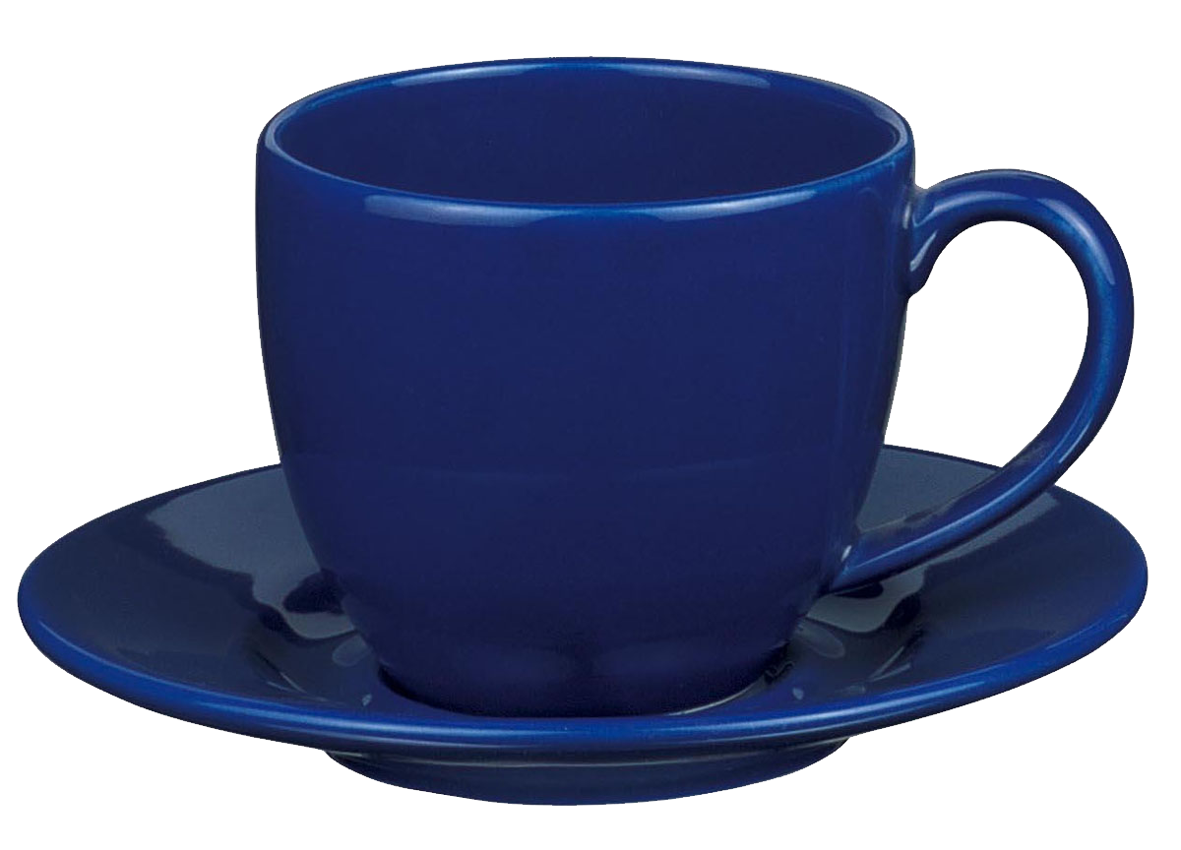
Estimation Game
Coffee Cup

Slide 19
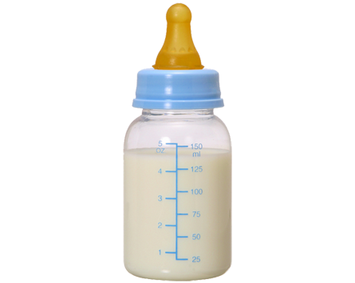
Estimation Game
Baby Bottle

Slide 20
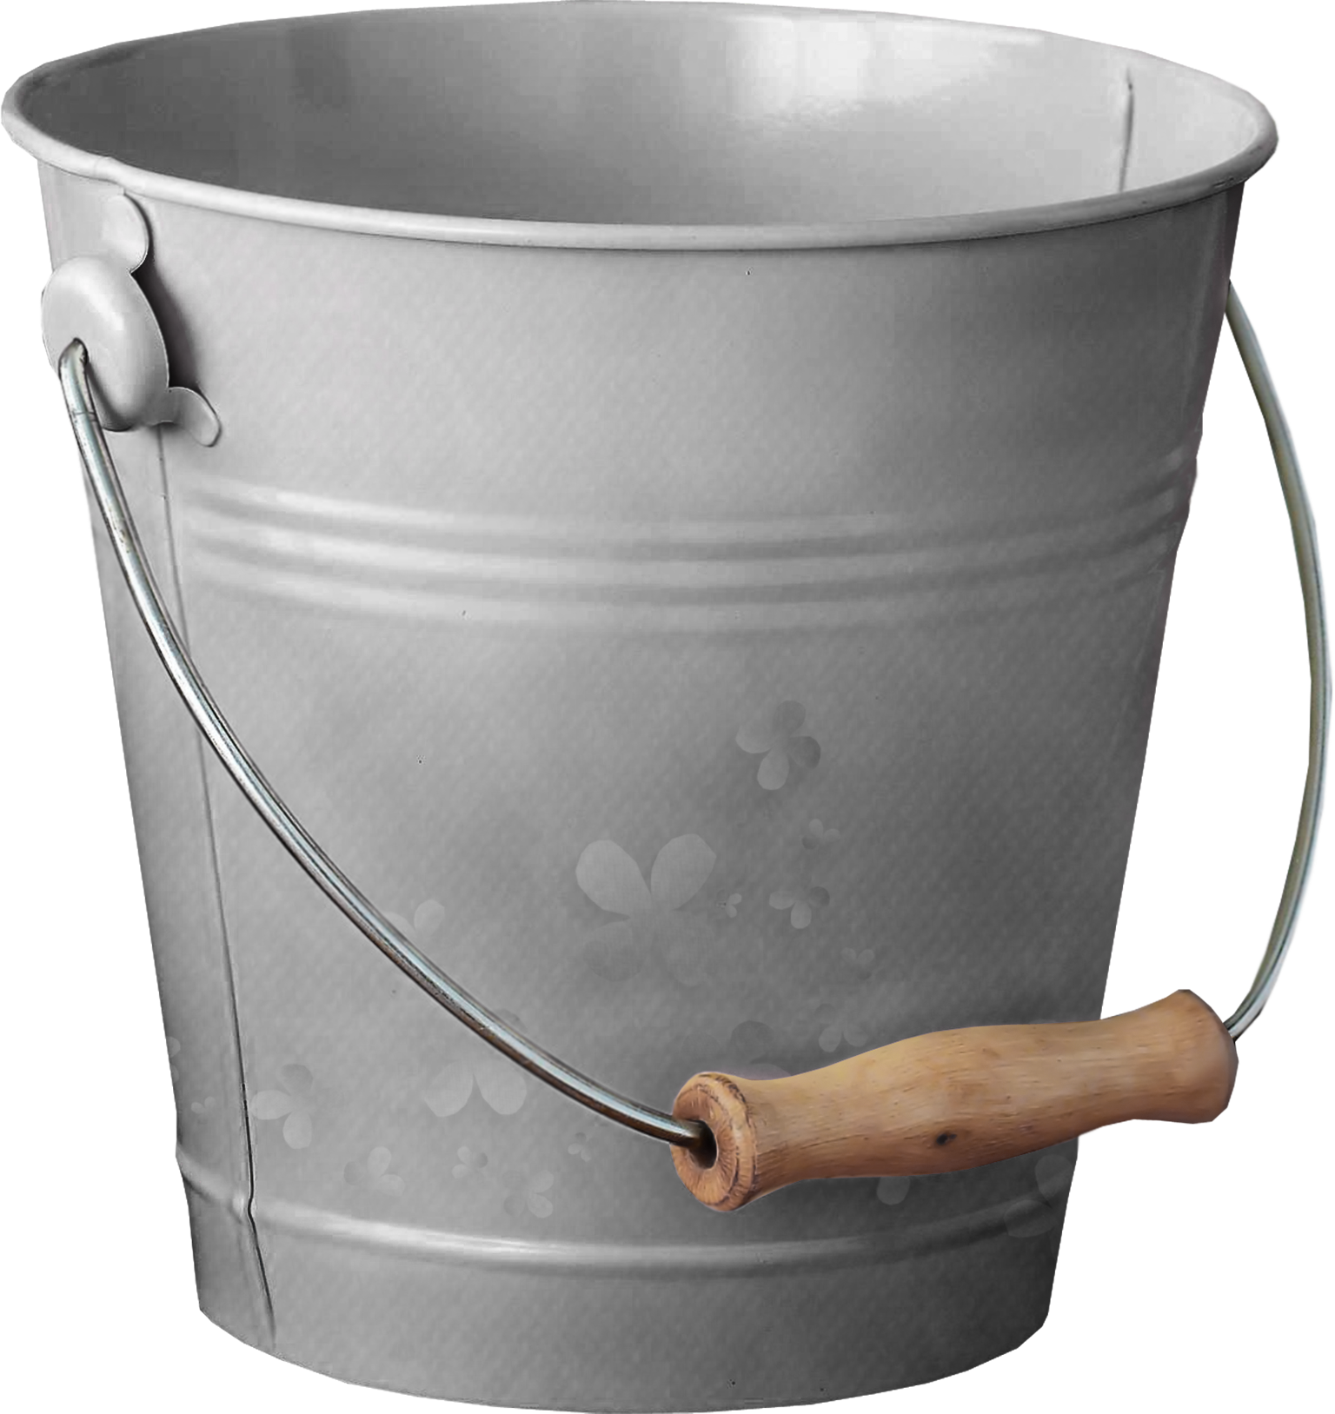
Estimation Game
Bucket

Slide 21
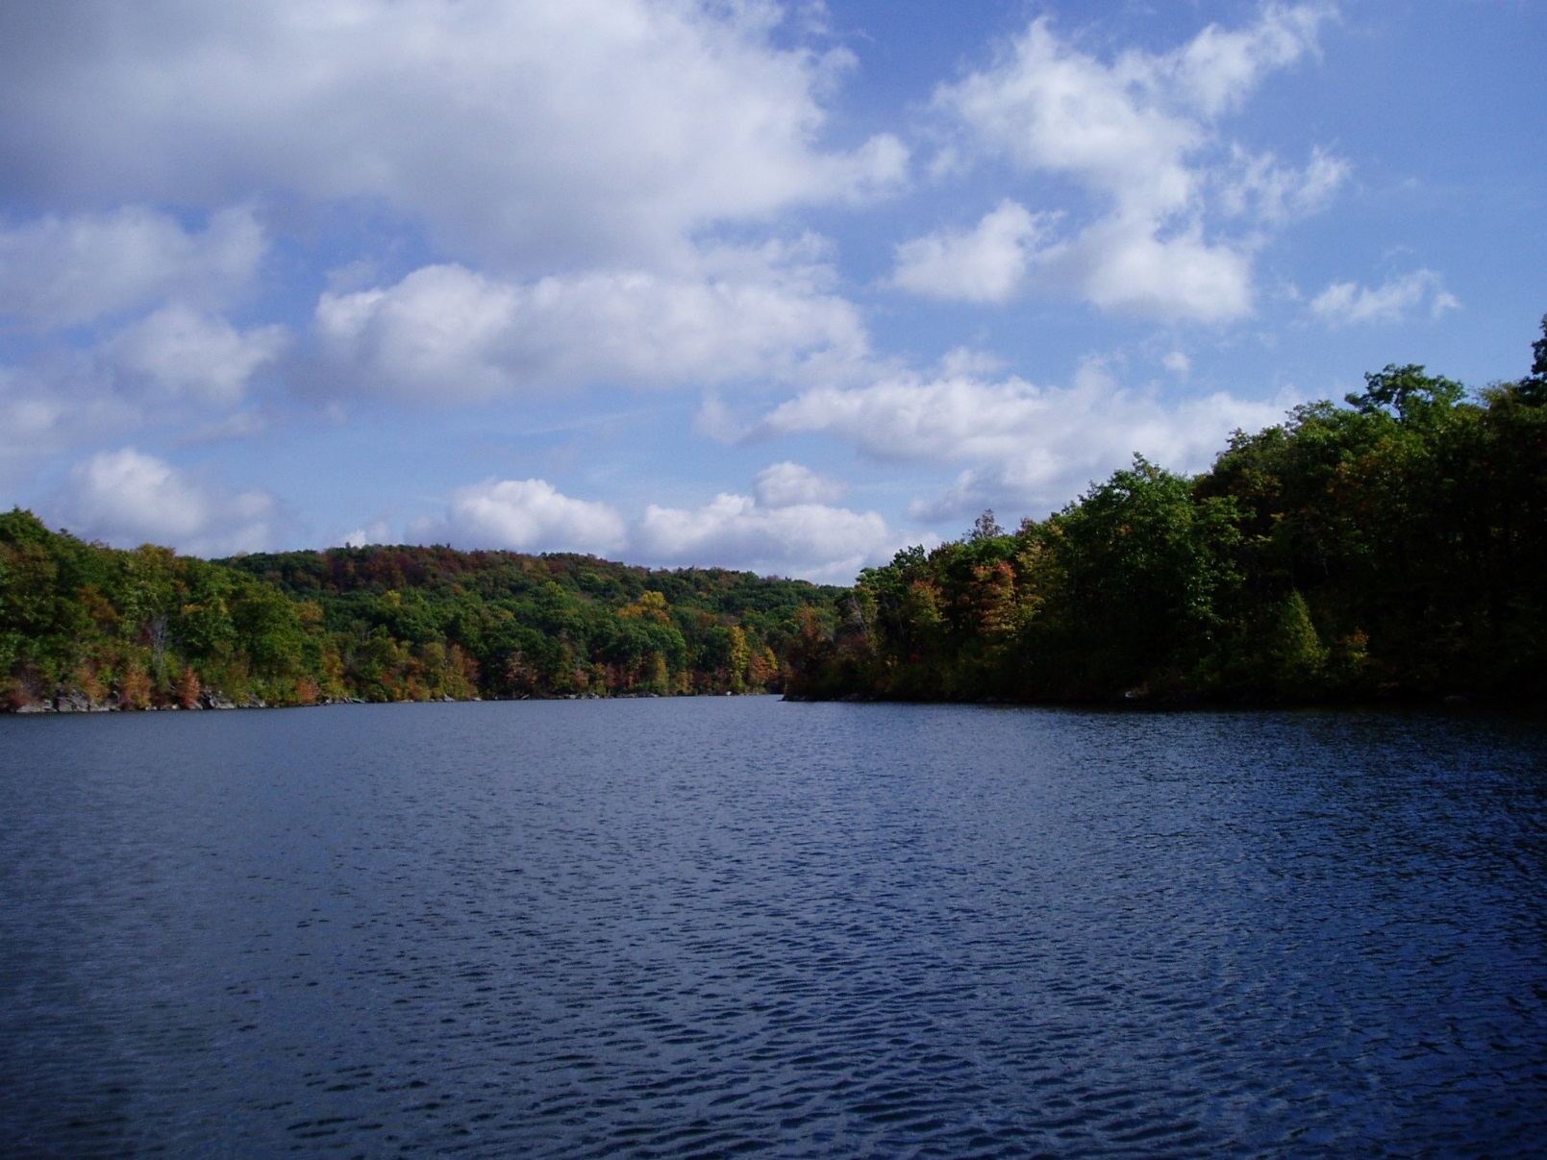
Estimation Game
Lake

Slide 22
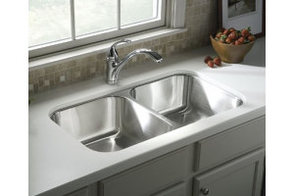
Estimation Game
Kitchen Sink

Slide 23
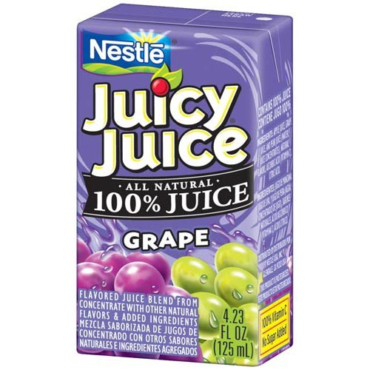
Estimation Game
Juice Box

Slide 24
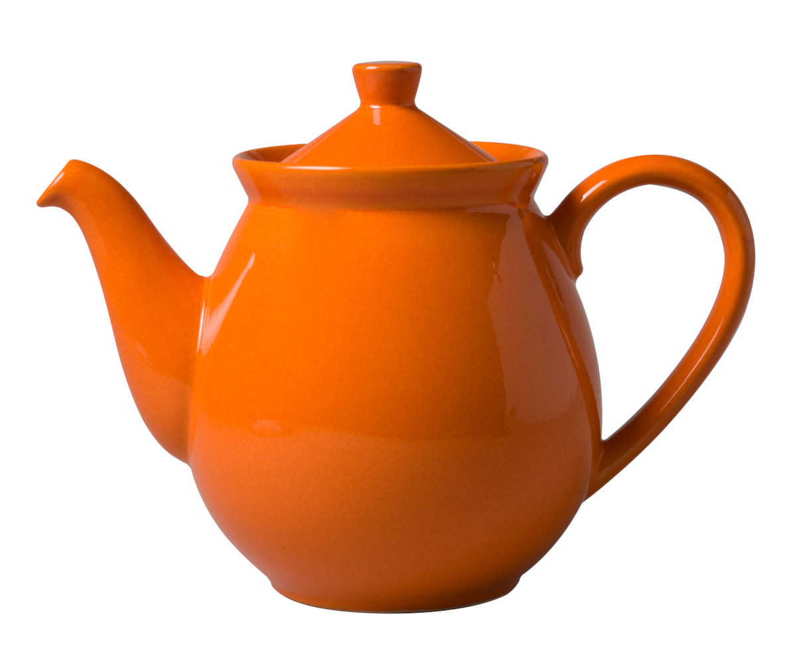
Estimation Game
Teapot

Slide 25
Book Activity
Complete pages 417-418 in your textbook.

Slide 26
Exit Ticket
Name something that holds about 1 liter.
Name something that holds just a few milliliters.

